Slide 1
Comprehensive Two-Year Mission
Mission Statement
The Mission of two-year education in Montana is to provide a comprehensive, accessible, responsive, student-centered learning environment that
facilitates and supports the achievement of
individuals’ professional and personal goals, and enhances the development of Montana’s citizens,
communities and economy.
Vision Statement
Montana’s two-year education: Transform lives and create opportunities through educating the
citizens of the state of Montana.

Slide 2
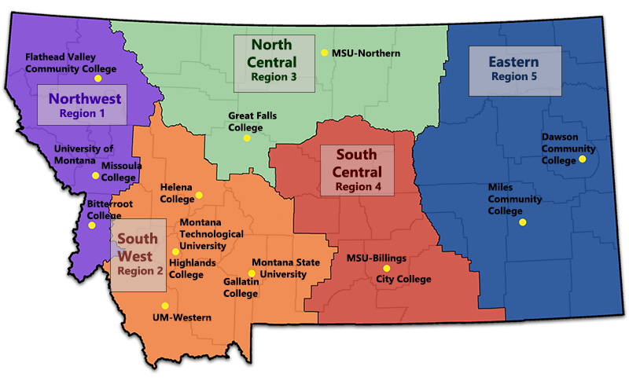
Map of Montana Colleges – 12 Two-year colleges
2
1
7 Tribal Colleges
1. Aaniiih Nakoda College
2. Blackfeet Community College
3. Chief Dull Knife College
4. Fort Peck Community College
5. Little Big Horn College
6. Salish Kootenai College
7. Stone Child College
7
4
6
5
3

Slide 3
What Certificates are offer at all these locations?
City College: Auto Collision Repair, Auto Refinishing, Auto technology, Carpentry, Craft Brewing, Diesel Tech., HR Management, Medical Coding, Ultrasound Tech., Welding and Fabrication.
Dawson: Corrections Officer, Corrosion Technology, HR and Management, Livestock and Ag. Business, Welding.
Flathead: Accounting, Baking Pastry, Biotechnology, Brewing, Electrical, Firearms Technologies, Entrepreneurship, Geospatial Technology, Heavy Equipment, Medical Assistant, Machinist, Nondestructive Testing, HVAC, Graphic Design, Personal Trainer, Welding.
Gallatin College: Bookkeeping, Business management, Carpentry, Machining, Cyber Security, Health Admin., HVAC, Medical Assisting, Network Technology, Phlebotomy, Welding.
Great Falls: Cybersecurity, Industrial Technician, Welding.
Helena: Bookkeeping, Entrepreneurship, Fire and Emergency Services.
Highlands: Health Information Technology, Pre-Apprenticeship.
Miles City: Accounting, Agriculture, Ag. Business, Customer Relations, Entrepreneurship, Business Fundamentals, Graphic Design, Meat Processing, Networking, PC Maintenance, Phlebotomy, Sales and Marketing.
Western: Business, Early Childhood, Farrier, Infant and Toddler, Glass Certificate, Small Animal Grooming.
Missoula: 10 in Business Services, 6 in Construction Trades, CDL, Heavy Equipment, 3 – Computing, 1- Culinary Arts, 3 Allied Health, 1 Chemical Addiction.
Northern: Diesel, Sports Coaching, Water Quality, Welding.

Slide 4
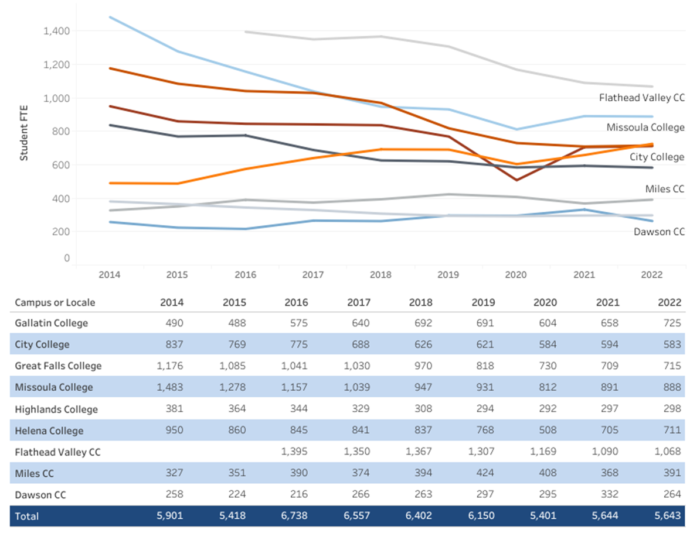
Gallatin College MSU Full-Time Equivalent Enrollment 2014-2022 Fall FTE has grown by 32% in the last 8 years
Gallatin College 490 488 575 640 692 691 604 658 725

Slide 5
Gallatin College MSU operates in 9 locations in the Valley

Slide 6
Gallatin College Montana State University
Only college without a designated building. Fastest growing counties with high job growth, and consistently high unemployment.
All the other colleges you saw listed have over 100,000 sq. ft buildings.
Gallatin College MSU has requested $46 million for a Career and Technical Trades building to support the future workforce needs of Southwest MT.
Public/Private investment.
Innovation: OneMSU, Sharing private/MSU spaces, cross training students, offering remote and hybrid learning where there is need.

