Slide 1
WIOA Providers and Funding – PY 2022

Slide 2
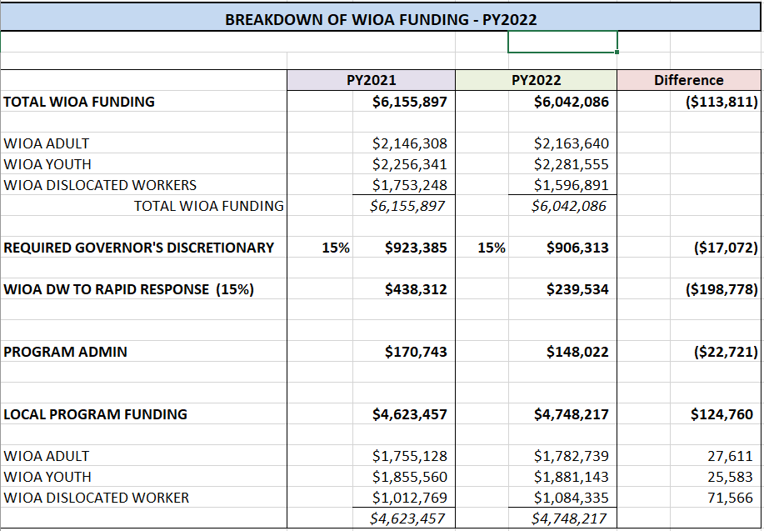
WIOA Funding - Overall

Slide 3
Local Areas
Local Area 1 – MACo Districts 8, 12 & Meagher County
Local Area 2 – Remainder of Montana

Slide 4
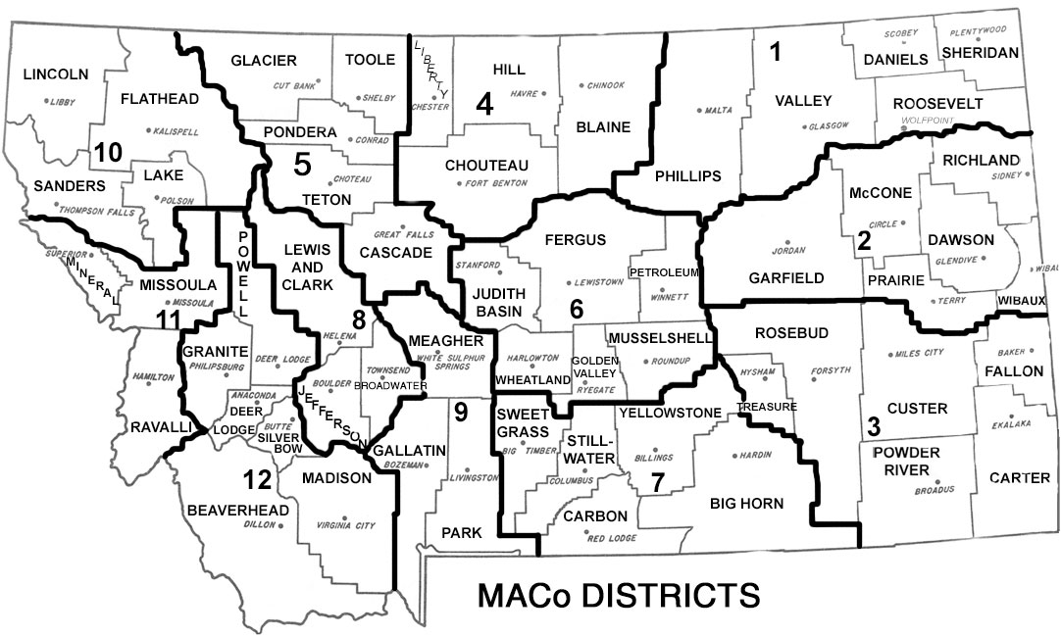
MACo Districts

Slide 5
Allocation Methodology – Adult & Youth

Slide 6
Allocation Methodology – Dislocated Worker
The same factors are used at a national and state level. The SWIB approved the above weights for distribution from a state level to a local area level.
The 90% Hold Harmless Rule applies by Local Area.

Slide 7
WIOA Service Providers
WIOA YOUTH
PY 2022 Service Providers
Dist 1 | Action for Eastern Montana
Dist 2 | Action for Eastern Montana
Dist 3 | Action for Eastern Montana
Dist 4 | District 4 HRDC
Dist 5 | Opportunities, Inc.
Dist 6 | District 6 HRDC
Dist 7 | District 7 HRDC
Dist 8 | Career Training Institute
Dist 9 | District 9 HRDC
Dist 10 | Jobs for Montana's Graduates
Dist 11 | District 11 HRDC
Dist 12 | Action, Inc.
WIOA Dislocated Worker
PY 2022 Service Provider
Statewide | Job Service Operations Bureau

Slide 8
WIOA Service Providers
WIOA ADULT
PY 2022 Service Providers
Dist 1 | Job Service Operations Bureau
Dist 2 | Job Service Operations Bureau
Dist 3 | Job Service Operations Bureau
Dist 4 | Job Service Operations Bureau
Dist 5 | Job Service Operations Bureau
Dist 6 | District 6 HRDC
Dist 7 | Job Service Operations Bureau
Dist 8 | Career Training Institute & Job Service Operations Bureau
Dist 9 | Job Service Operations Bureau
Dist 10 | Job Service Operations Bureau
Dist 11 | Job Service Operations Bureau
Dist 12 | Career Futures & Job Service Operations Bureau

Slide 9
WIOA Adult Funding
ADULT
 | PY22 Allocation |  | PY21 Allocation |  | Difference
Dist 1 | 110,624 |  | 107,467 |  | 3,157
Dist 2 | 101,904 |  | 98,996 |  | 2,908
Dist 3 | 110,047 |  | 106,906 |  | 3,141
Dist 4 | 101,609 |  | 98,709 |  | 2,900
Dist 5 | 217,928 |  | 211,708 |  | 6,220
Dist 6 | 107,353 |  | 104,289 |  | 3,064
Dist 7 | 235,436 |  | 228,718 |  | 6,718
Dist 8 | 131,672 |  | 138,727 |  | (7,055)
Dist 9 | 85,479 |  | 83,074 |  | 2,405
Dist 10 | 229,144 |  | 222,604 |  | 6,540
Dist 11 | 200,704 |  | 194,976 |  | 5,728
Dist 12 | 150,839 |  | 158,954 |  | (8,115)
 | 1,782,739 |  | 1,755,128 |  | 27,611

Slide 10
WIOA Youth Funding
YOUTH
 | PY22 Allocation |  | PY21 Allocation |  | Difference
Dist 1 | 93,822 |  | 92,448 |  | 1,374
Dist 2 | 69,805 |  | 68,785 |  | 1,020
Dist 3 | 88,468 |  | 87,174 |  | 1,294
Dist 4 | 100,406 |  | 98,937 |  | 1,469
Dist 5 | 226,355 |  | 223,043 |  | 3,312
Dist 6 | 65,202 |  | 64,247 |  | 955
Dist 7 | 298,028 |  | 293,671 |  | 4,357
Dist 8 | 109,186 |  | 108,415 |  | 771
Dist 9 | 176,354 |  | 173,811 |  | 2,543
Dist 10 | 248,225 |  | 244,606 |  | 3,619
Dist 11 | 269,971 |  | 266,058 |  | 3,913
Dist 12 | 135,321 |  | 134,365 |  | 956
 | 1,881,143 |  | 1,855,560 |  | 25,583

Slide 11
WIOA Dislocated Worker Funding
Dislocated Worker
 | PY22 |  | PY21 |  | Difference
WIOA DISLOCATED WORKER | 1,084,335 |  | 1,012,769 |  | 71,566
WIOA RAPID RESPONSE | 239,534 |  | 438,312 |  | (198,778)
Dislocated Worker
 | PY22
Local Area 1 | 178,185
Local Area 2 | 906,150
 | 1,084,335

