Slide 1
Workforce Innovation
and Opportunity Act:
Vision Purpose Titles/Programs Allocations and Process Eligibility

Slide 2
Vision
To achieve and maintain an integrated, job-driven workforce system that links our diverse, talented workforce to our nation’s businesses and improves the quality of life for our citizens.
Based on three key pillars of our system:
One-Stop career centers provide first-rate customer service to jobseekers, workers, and businesses.
The demands of businesses and workers drive workforce solutions.
The workforce system supports strong regional economies.
WIOA
Notes:
We function as a single area state (One region) and with two local areas.

Slide 3
What is the purpose of WIOA programs?
Under WIOA, workforce development programs provide resources for education and training services that:
Prepare individuals for work to meet current employer needs; through,
Assessments, career coaching, occupational skill training, classroom training, supportive services, and on-the-job training; and,
Workforce activities customized to meet the needs of individuals customers – both business customers and Jobseekers
Notes:
According to an Institute for Women’s Policy Research report, the majority of participants who received between
12 one and three supportive services, completed their training.
Supportive services include Transportation, auto repair, assistance with child care costs, housing, tools, uniforms, etc.

Slide 4
WIOA Titles
Title I Programs
Title I is the primary source of federal workforce development funding to prepare youth, adults, and dislocated workers for employment and help build necessary skills to continue and advance in employment
Notes:
These are referred to as “core programs”

Slide 5
WIOA Titles
Title II & Title III Programs
Title II is the main source of federal adult education and literacy funding, including English language services.
Title III funds the Wagner-Peyser Employment Services program, which provides labor exchange services that match employers with qualified job seekers.
Notes:
These are also referred to as “core programs”
https://www.dol.gov/agencies/eta/american-job-centers/wagner-peyser
Section (a) of the WP Act states in part “Ninety percent of the sums allotted to each State pursuant to section 6 may be used--
(1) for job search and placement services to job seekers, including unemployment insurance claimants, including counseling, testing, occupational and labor market information, assessment, and referral to employers;”
Section (b) states “Ten percent of the sums allotted to each State pursuant to section 6 shall be reserved for use in accordance with this subsection by the Governor of each such State to provide--
(1) performance incentives for public employment service offices and programs,
(2) services for groups with special needs, and
(3) the extra costs of exemplary models for delivering services of the types described in subsection (a), and models for enhancing professional development and career advancement opportunities of State agency staff, as described in section 3(c)(4).

Slide 6
Eligibility for WIOA programs
For Adult services:
Be 18 years old or older;
Be a U.S. Citizen or Registered Alien;
Meet Selective Service registration requirements (if applicable).
For DW services:
Same as above plus needs to be unemployed (several criteria listed)
For Youth services:
Out of school (75%) or In School youth (25%)
Reference TEGL 9-21
Notes:
Feds also require us to prioritize services to Vets, spouses of Vets, low income, basic skills deficient, those that need the services most. Also, WIOA is to be utilized after other resources have been exhausted.. For example, if PELL grant eligible, that pays first and then WIOA..

Slide 7
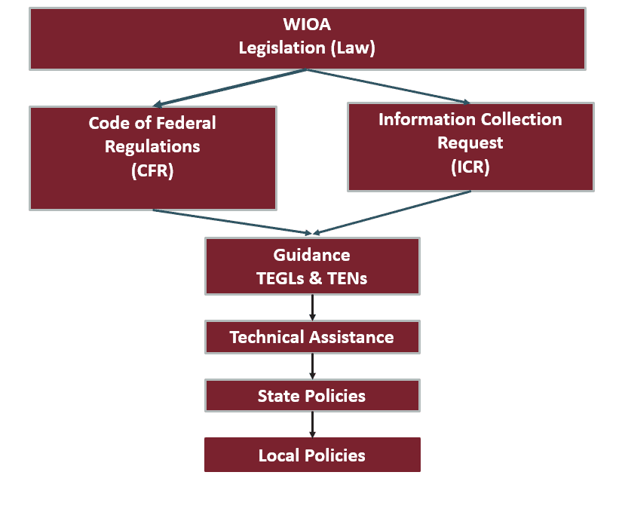

Slide 8
Overview of Allotment Process
Congress passes a budget appropriating funds
The Act makes all (100%) of the Youth program funds available for obligation on April 1;
A portion (18%) of the WIOA Adult and Dislocated Worker (20%) funds are available for obligation on July 1, and the balance (82%/80%) on October 1;
States provide funds to Local Workforce Areas based on Within-State formulas adopted by State and consistent with WIOA

Slide 9
WIOA Youth and Adult Sub-State Allocations:
Must be allocated to local areas per
Formula or Discretionary rules
States must choose one of these allocation methods
Formula Allocation:
Must be equally split
Discretionary Allocation:
Ratio Split
≥ 70% ≤ 30%
ASU
Excess
Unemployment
Disadvantaged
Adult/Youth
Must be split in equal parts and must total no less than 70% of total funding
+
May be split at any ratio using both factors but no more than 30% of total funding
Minimum percentage (stop loss) applies
ASU
Excess
Unemployment
Disadvantaged
Adult/Youth
Excess Unemployment
Excess
Youth/Poverty
Minimum percentage (stop loss) applies
Minimum percentage (stop loss) may apply
Notes:
1/3 area of substantial unemployment (BLS data) – July 20 – June 21 (each state compared to ASU in all states)
1/3 excess unemployed in ASUs
1/3 disadvantaged adults/youth based on Census data – for youth they use the American Community Survey

Slide 10
WIOA Dislocated Worker Sub-State Allocations:
Must be allocated to local areas per
Formula created by the Governor
States must use the following six data factors using the most appropriate data available
Insured unemployment data
Unemployment concentrations
Plant closing and mass layoff data
Declining industries data
Farmer-rancher economic hardship data
Long-term unemployment data
Minimum percentage (stop loss) applies
Maximum percentage (stop gain) not required but may apply
Weighting a factor zero is not permitted unless a rational is presented in an approved State Plan
Notes:
Refer to Allocation Policy
Insured UI data – 60% (share of folks making a UI claim)
UI concentrations – 13% (share of unemployed in counties with 150% of state UI rate
Plant closings.. – 5% - layoffs of 50+
Declining industry = 10%
Farmer Rancher hardship = 2% (share of Chapter 12 bankruptcies)
Long terms UI – 10% = share of UI claims 16 weeks or longer

Slide 11
Funding for WIOA programs – PY22
Adult $2,163,640
DW $1,596,891
Youth $2,281,555
W-P (ES) $4,975,831
Under WIOA rules, the state can reserve up to 25% of the DW budget for rapid response
The State can set aside 15% of the Adult, DW, and Youth allocations for a Governors reserve to be used for “statewide activities”;
Wagner Peyser allocation is subject to a 10% set aside
Notes:
State with Governor approval can transfer 100% of Ad to DW and vice versa
Rapid Response are to 1) help businesses avert layoffs and 2) respond to significant layoff events
- Can include funding feasibility studies to determine if a company’s operations may be sustained through a buyout or

Slide 12
Eligible Training Provider List
WIOA requires that only approved training providers can be paid with WIOA program funds
Registered Apprenticship programs are automatically listed
Providers are required to provide MDLI program data like type of training, outcomes, SSN, etc.
https://montanaworks.gov/training
Notes:
Here is the list of approved trainings and providers. School or Vendor, type of certificate, degree, etc. and program description. We also have recipricocity agreements with surrounding states – we can use their approved vendors. i.e. Dakotas, Idaho, Alaska, Arizona, Utah, WA and Wyoming
Number of Providers - 484

