Slide 1
Slide 1
THE IMPACT
OF CHILD CARE
Presented by:
Tori Sproles, M.Ed.
Executive Director, Child Care Connections

Slide 2
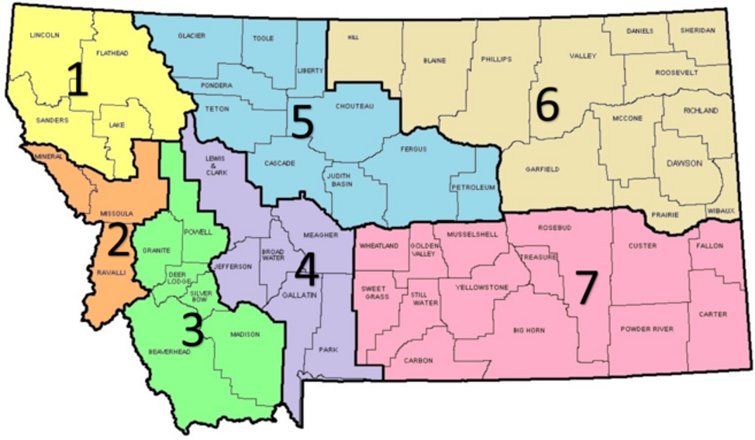
Slide 12
WHO ARE WE?
ABOUT CHILD CARE CONNECTIONS
Child Care Connections (CCC) advocates for the well-being and quality care of children by supporting early childhood professionals, families, and the communities we serve.
We are the sole Child Care Resource and Referral Agency for six counties, including:
Gallatin
Park
Meagher
Lewis & Clark
Jefferson
Broadwater
CCC Offices in Bozeman and Helena
https://cccmontana.org/
https://mtchildcare.org
Notes:
Child Care Connections is a non-profit organization and one of seven resource and referral agency within the state of Montana. Our main office is in Bozeman and we have a satellite office in Helena. We service the counties of Gallatin, Park, Meagher, Jefferson, Lewis and Clark and Broadwater. Our mission is to advocate for the well-being and quality care of children by supporting early childhood professionals, families and the communities we serve. Our Provider Services department is committed to support Early Childhood Professionals through quality trainings, coaching, technical assistance and resources. Our Family Services department assists families with finding childcare and through the administration of the Best Beginnings Scholarship helps to offset the high cost of childcare for low-income families. We support our communities through our Child Safety Program which focuses on bike and vehicle safety. We offer bike rodeos, free helmets, car seat fittings and also help with emergency preparedness to help keep young children safe.

Slide 3
CHILD CARE CHALLENGES AT A GLANCE
If all Montana children under five were given access to quality early care and education at a cost of an additional $197 million, that investment would generate $317 million in total new spending in Montana businesses.
https://www.epi.org/child-care-costs-in-the-united-states/#/MT http://lmi.mt.gov/Portals/193/Publications/LMI-Pubs/Articles/2018/0918-ChildcareInMontana.pdf
https://www.americanprogress.org/issues/early-childhood/reports/2019/03/28/467488/child-care-crisis-keeping-women-workforce/
http://s3.amazonaws.com/mildredwarner.org/attachments/000/000/169/original/report-5755193a.pdf
Notes:
As you know, Montana is suffering from a child care shortage. Currently, MT is only meeting 47% of the demand for child care. Licensed child care programs are full with waitlists in most cases and any opening available only support preschool aged children. In addition to the shortage of child care, the high cost to access child care is another barrier. Currently, Montana facilitates the best beginnings scholarship application which help low income families pay for child care, this program is income eligible and is based on 185% of the Federal Poverty Level. Recently, we are seeing a 52% approval rate statewide for scholarship applications, this is down from 75% in 2019. Ineligibility for the scholarship has many factors including income guidelines and other qualifications such as child support requirements. And lastly, the child care workforce is underpaid and undervalued. Child care providers in MT make an average of $11-12 an hour which equates to 125% of the Federal Poverty Level for a family of 2. We are going to look at each of these challenges briefly.

Slide 4
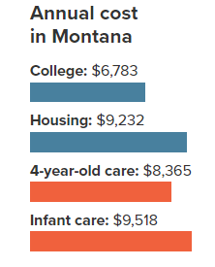
According to the U.S. Department of Health and Human Services (HHS), child care is affordable if it costs no more than 7% of a family’s income. By this standard, only 12.0% of Montana families can afford infant care. A typical family in Gallatin County and Lewis & Clark County spends over 25% of their income on child care for one infant and one toddler.
https://www.epi.org/child-care-costs-in-the-united-states/#/MT
http://lmi.mt.gov/Portals/193/Publications/LMI-Pubs/Articles/2018/0918-ChildcareInMontana.pdf
Notes:
The average household in Gallatin county has 2 children.

Slide 5
Slide 12
CHILD CARE COSTS EXPLAINED
Why child care is so expensive and early care educators, with Bachelor Degrees, paid so little:
Parent fees alone are not enough funding
Labor intensive field
Requires low adult to child ratios
Cost breakdown:
12% to overhead, utilities, maintenance
23% classroom materials, food, and admin
65% for personnel
Ex: A center with 40 full-time children needs a minimum of 10 teachers.
Despite the high cost of licensed child care, early childhood professionals have some of the lowest wages in our state.
45%
A median child care worker in Montana would have to spend 45.0% of her earnings to put her own child in infant care.
https://cscce.berkeley.edu/why-do-parents-spend-so-much-on-child-care-yet-early-childhood-educators-earn-so-little/?utm_source=7/11+CCA/CSCCE+video-+Why+do+parents+spend+so+much+on+child+care&utm_campaign=video+CCA+july+2018&utm_medium=email
https://www.epi.org/child-care-costs-in-the-united-states/#/MT
https://lmi.mt.gov/Portals/193/Publications/LMI-Pubs/Labor%20Market%20Publications/EAG-0419.pdf
Notes:
Child care costs may be high, but the early childhood professionals who care for our youngest citizens are paid some of the lowest wages imaginable. On average, a child care provider makes $11-12/hour as mentioned on the previous slide. Most child care programs are small businesses and parent fees alone are not enough to have a sustainable business.

Slide 6
CHILD CARE WORKFORCE
Challenges
Recruitment and retention
Wages, benefits
Stress
Cost of Care
Undervalued
Possible Solutions
Federal funding
Financial aid to providers
Respect for the profession
Employer Supported Care
https://info.childcareaware.org/hubfs/2022-03-FallReport-FINAL%20(1).pdf?utm_campaign=Budget%20Reconciliation%20Fall%202021&utm_source=website&utm_content=22_demandingchange_pdf_update332022
Notes:
The child care workforce in the nation has only recovered to 84% if pre-pandemic levels. This number continues to ebb and flow.

Slide 7
CHILD CARE AND THE WORKFORCE
Research estimates an annual economic cost of $57 Billion is lost in earnings, productivity, and revenue every year in the U.S. due to child care.
40%
of MT's businesses report difficultly recruiting or retaining qualified workers due to the lack of affordable child care in their community.
40%
An on-site child care program can reduce employee turnover by 60%.
of parent’s work schedules are affected by child care challenges an average of 7.5 times over a six-month period.
https://www.childcareaware.org/our-issues/research/the-us-and-the-high-price-of-child-care-2019/ https://www.americanprogress.org/issues/early-childhood/reports/2019/03/28/467488/child-care-crisis-keeping-women-workforce/
Notes:
Child care availability and affordability directly impact the workforce. Child care is a workforce and economic development issue. It’s a major challenge for employers to retain staff because of a lack of reliable and affordable child care for families.

Slide 8
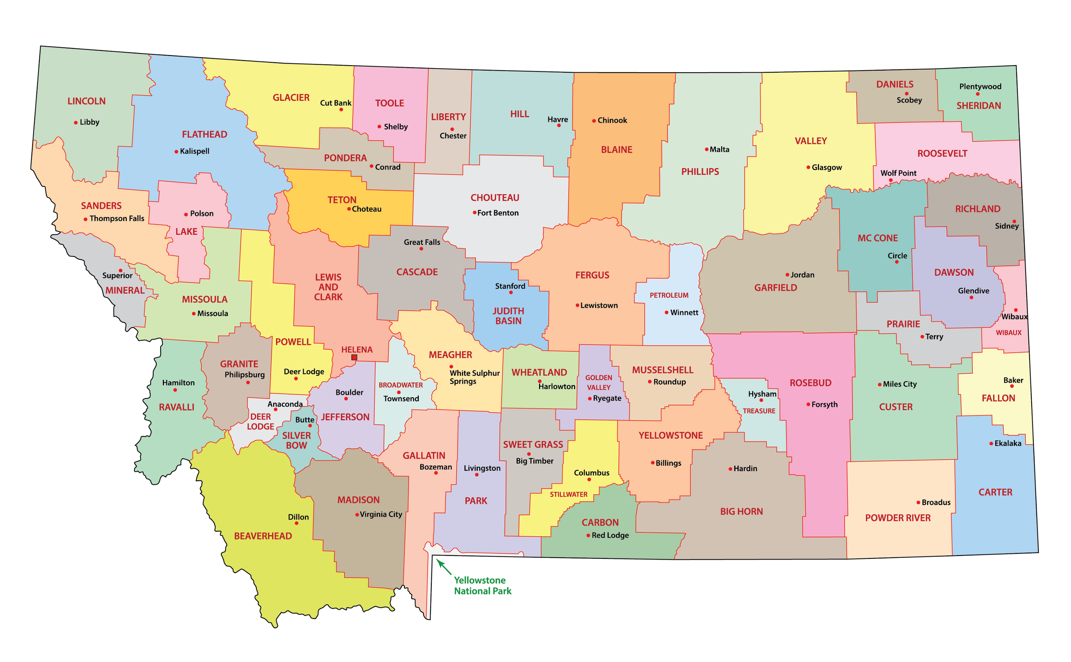
What are we doing?
Statewide
ARPA Funds
Stabilization Grants
Workforce Incentives
Expansion Grants
Innovation Grants
Licensing regulations revision
Locally
CHILD Task Force
Employer Supported Child Care
Innovations Grant
Workgroups
Child Care Workforce
Community Initiatives
Business Supports
Financial

Slide 9
CHILD (Cooperative, Holistic, Innovative, Local, Design) Task Force
CHILD CARE WORKFORCE
Salary study
Professionalizing the field
Supports for people entering the workforce
FINANCIAL
Financial model for child care businesses
Innovative financial solutions for child care
COMMUNITY INITIATIVES
Access to training for child care providers.
Breaking down child care barriers
Shared services for providers
BUSINESS SUPPORTS
Surveying employers/ employees about child care needs
Employer supported tiered implementation
Task Force Members
Child Care Connections, HRDC, Northern Rocky Mountain Development, MT Early Childhood Project, Big Sky Chamber of Commerce, Spanish Peaks Community Foundation, Gallatin College, Gallatin United Way, MT State Legislators, West Yellowstone Chamber of Commerce, Financial institutions, MT Department of Labor & Industry and more.

Slide 10
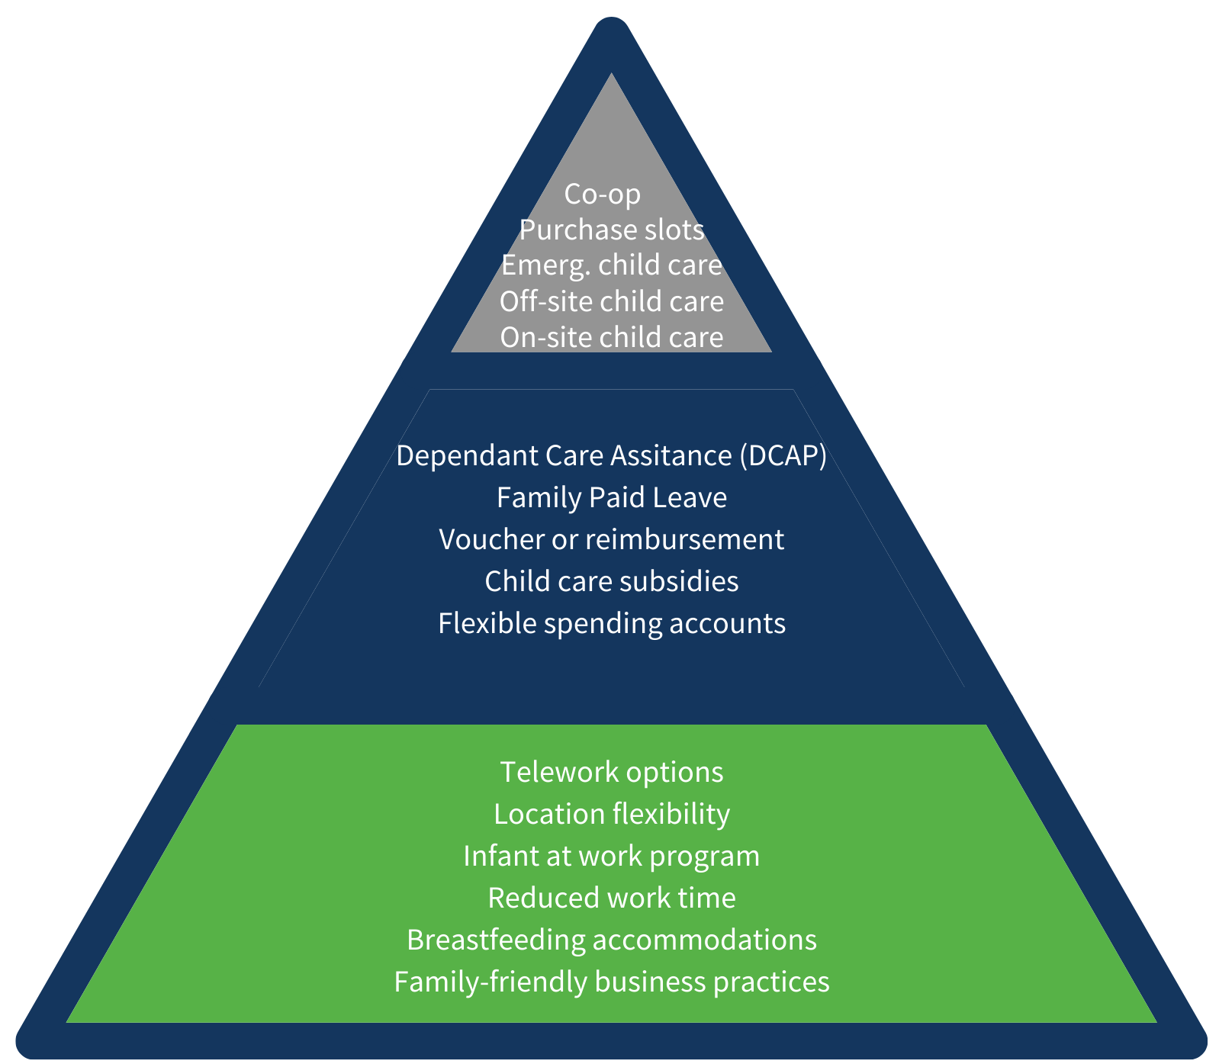
HOW MONTANA BUSINESSES CAN SUPPORT EMPLOYEES
Tier 3-Access to Child Care
Tier 2- Financial Assistance
Tier 1-Organizational Practices
https://www..familyforwardmt.org
Notes:
This employer supported child care tiered model was created by an initiative called Family Forward through Zero to Five. It breaks down the three levels of how employers can support their employees.

Slide 11
Ways to Support the Child Care System
Policy Revision
Best Beginnings Child Care Scholarship Eligibility
Expand income guidelines
Review barriers (i.e. child support)
Child Care Licensing
Review barriers (in progress)
Community Engagement
Community budget
Sponsor an existing child care program
Providing materials
Monetary supports
Travel stipends or transportation
Housing
Recruitment of staff
Child Care Scholarships for families (gap supports outside of state subsidy)
Employer Supported Child Care

Slide 12
Thank you!
To request a copy of this presentation and discover other helpful materials to help you support the child care needs of your employees, contact:
tori@cccmontana.org or call (406) 548-3672
Child Care Connections
Tori Sproles, M.Ed. Executive Director
1143 Stoneridge Dr
Bozeman, MT 59718
(406) 587-7786
office@cccmontana.org cccmontana.org

Slide 13
Follow us on Social Media
Instagram
@CCCMontana
Facebook
Child Care Connections-- facebook.com/CCCMontana
Child Care Share Helena Area-- facebook.com/groups/ccshelena/
Twitter
Child Care Connections MT @CCC_Montana
Website
cccmontana.org

