Slide 1
PRIMARY SECTOR WORKFORCE TRAINING GRANT PROGRAM
State Workforce Innovation Board Meeting-February 23, 2016

Slide 2
PURPOSE
Provides grants to Primary Sector businesses for training of new full-time and part-time workers with the purpose of creating new jobs in Montana.

Slide 3
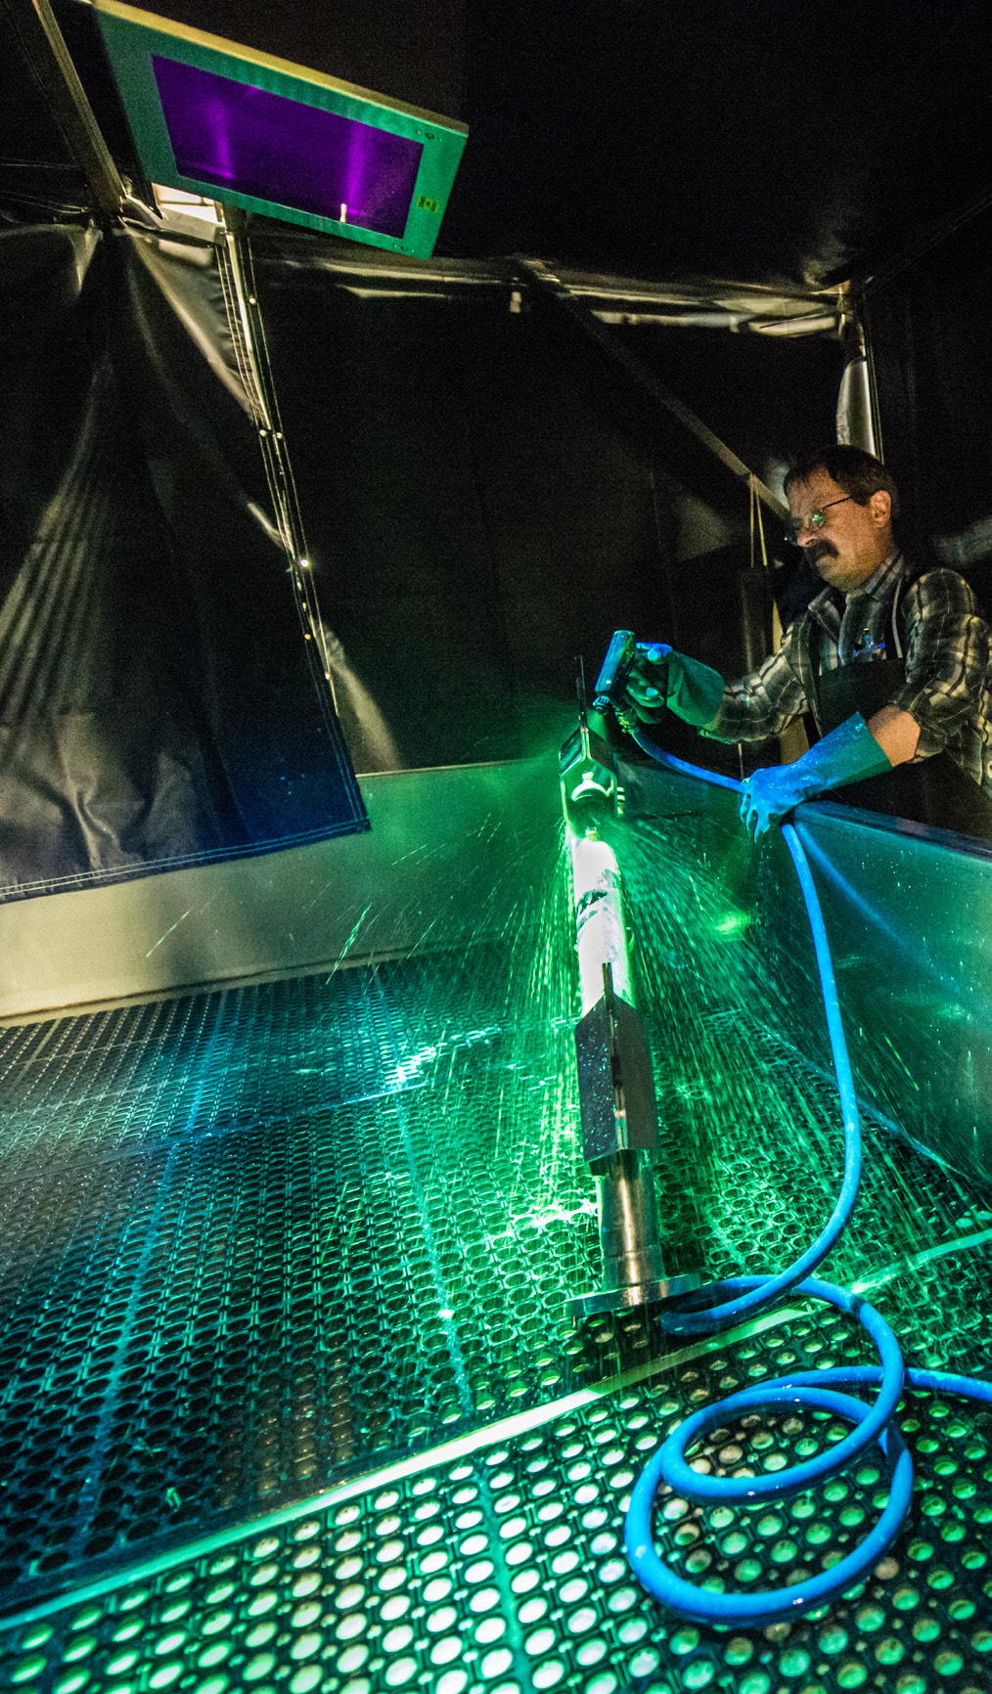
ELIGIBLE APPLICANTS
Eligible Business
Primary Sector - 50% of sales outside of the state of Montana
Manufacturing company with at least 50% of its sales to other Montana companies that have 50% of their sales occurring outside of Montana;
New business that provides a product or service that is not available in Montana, which results in state residents leaving the state to purchase the product or service.
Create at least one job
Wage Requirements
Trainees must be paid at least 170% of Montana current minimum wage. Benefits can be used in this calculation.
Need for training for the employees

Slide 4
HOW MUCH CAN I APPLY FOR?
$5,000 maximum for each full-time (averaging 35 hours per week) job; Statute does provide for some exceptions to the funding ceiling.
$2,500 maximum for each part-time (averaging 25-34 hours per week) job;
$1 in match for every $3 of WTG funds awarded.

Slide 5
COMMON TYPES OF TRAINING
Used for direct training costs, such as:
Hiring consultant to teach
Cost of attending training
Training assessment and testing
On-the-Job (job shadowing)

Slide 6
EXAMPLES OF FUNDED PROJECTS
ADF International, Inc. 120 full-time jobs - $600,000
Bacterin International, Inc. 13 jobs - $65,000
Transco Railcar Repair, Inc.
55 full-time jobs - $275,000
Pioneer Aerostructures, LLC 14 full-time and 2 part-time jobs - $75,000

Slide 7
INNOVATION
SB 163 created Special Revenue Fund
Recaptured $267,734.81
(44% of annual appropriation)
All recaptured funds have already been committed to train an additional 53.5 jobs.
Notes:
6,506,657 of unspent WTG funds were returned to General Fund;
Loss of 1,301 net new jobs being trained

Slide 8
PARTNERSHIPS
DLI position on Review Committee
Opportunities
Coordination
Quarterly Informational Meetings
Outreach (JSEC, Job Service)

Slide 9
CONTACTS
Karyl Tobel, Bureau Chief 841-2732
Annmarie Robinson, Section Manager 841-2250
Janice Wannebo, Program Specialist 841-2741
www.wtg.mt.gov

Slide 10
QUESTIONS

