Slide 1
Veteran Resources Department of Labor Jobs for Veterans 10/19/2022
Nick Moschetti – state of Montana Veterans Program coordinator

Slide 2
Overview
Empowering Montanans Through Work and Opportunity
Job Service’s across Montana provides employment assistance to Veterans and eligible persons via a DOL Jobs for Veterans State Grant (JVSG). (Career Services)

Slide 3
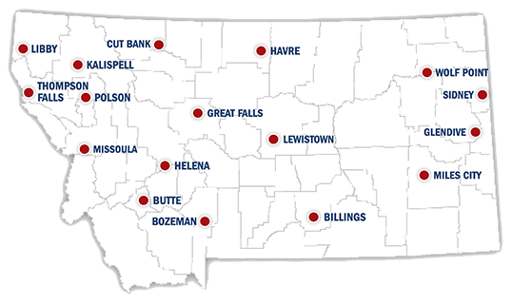
Statewide Job Service Locations
Trained, equipped, and ready to serve!

Slide 4
Montana Veteran Statistics

Slide 5
Montana Veteran Statistics

Slide 6
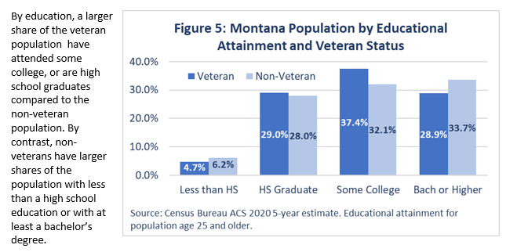
Montana Veteran Statistics

Slide 7
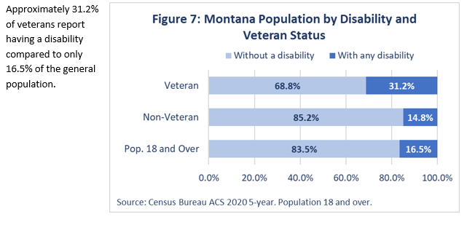
Montana Veteran Statistics

Slide 8
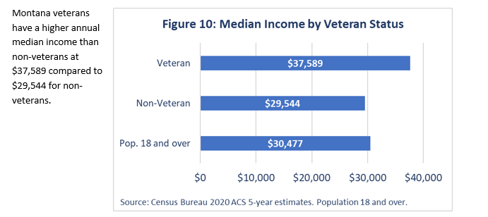
Montana Veteran Statistics

Slide 9
Montana Veteran Statistics
In 2021, Montana had approximately 205 homeless veterans which constitutes roughly 15% of Montana’s homeless population according to the U.S. Department of Housing and Urban Development point in time estimates.
By state, Montana has the highest share of homeless population who are veterans. HUD point-in-time homelessness estimates are available at https://www.hud.gov/2019-point-in-time-estimates-of-homelessness-in-US
By state, Montana has the highest share of homeless population who are veterans. HUD point-in-time homelessness estimates are available at https://www.hud.gov/2019-point-in-time-estimates-of-homelessness-in-US

Slide 10
Montana Veteran Statistics
Montana’s rate of veteran suicide is higher than the national average with 58.2 veteran suicides per 100,000 veterans compared to a national rate of 31.6 veteran suicides per 100,000 veterans. In 2020, there were 53 veteran suicides in Montana.
According to Veteran’s Administration Montana Veteran Suicide Data sheet, 2020. https://www.mentalhealth.va.gov/docs/data-sheets/2020-State-Data-Sheet-Montana-508.pdf
According to Veteran’s Administration Montana Veteran Suicide Data sheet, 2020. https://www.mentalhealth.va.gov/docs/data-sheets/2019/2019-State-Data-Sheet-Montana-508.pdf

Slide 11
Jobs for Veterans State Grant
(JVSG) Program
Purpose: State Grant Program supporting dedicated staff that provide individualized career and training related services to veterans and eligible persons with significant barriers to employment and to assist employers fill their workforce needs to job seeking veterans.
Support dedicated staff in the positions as:
Disabled Veteran Outreach Program (DVOP) Specialists provide intensive services to veterans with significant barriers to employment.
Local Veteran Employment Representative (LVER )staff conduct outreach to employers and business associations and engage in advocacy efforts to increase employment opportunities for veterans.
Consolidated Position Staff – serve in dual roles as DVOP and LVER.
Authorization: Title 38 (Section 4102A (b) 5 (38 U.S.C. §4102A(b)5
Grant Awards: Provided to 54 State Workforce Agencies (SWAs) based on a funding formula used to determine each states’ amount of “job seeking veterans”

Slide 12
DVOP Support
DisABLED Veteran Outreach Program Representatives (DVOPs):
Provide career services to meet the employment needs of veterans who are economically or educationally disadvantaged, disabled, homeless or facing other barriers to employment.
Assist veterans in overcoming employment barriers through comprehensive case management that may include coordination with workforce training partners and community-based organizations.

Slide 13
Who Enlists in the All-Volunteer Force?
High-quality, drug-free, law-abiding, smart, and educated young men and women enlist to serve our nation to be part of something greater than themselves.
Enlistment standards are stringent. Only 13% of 17-to-24-year-olds are qualified to enlist without a waiver.
It is harder to be accepted into the military than it is by most secondary education institutions, which usually only screen for diplomas and mental aptitude.
Combat arms occupations (e.g., infantry, artillery, combat engineers, armor, etc.) have some of the highest enlistment quality metrics.
Women represent about 15% of the enlisted force and about 18% of the officer ranks. • Nearly all enlisted service members have traditional high school diplomas.
About 79% test above 50th percentile in aptitude tests.

Slide 14
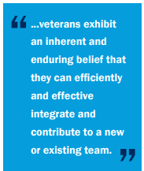
Business Case for Hiring disABLED Veterans
The Business Case for Hiring Veterans
A quick internet search shows articles from many recognized business leaders who endorse hiring
veterans as a good business practice. Why? Veterans bring the following attributes and characteristics
to the workplace:
• Proven leadership and leadership readiness
• Mission-focused approach to work
• Experience working in diverse teams and organizations
• Adaptable and immediate contributors
• Strong work ethics
• Strong performance under pressure
• Creative problem-solving
• Self-starter
• Integrity
• Technical skills (military experience exposes individuals to advanced technology or technical training)
• Loyalty (The military is adept at institutional socialization and cultivating loyalty. A trait civilian
employers have found among their employees who are veterans. A low turnover rate can lead to a
higher return on investment for businesses.)

Slide 15
Work Opportunity Tax Credit
Federal tax credit for hiring individuals from certain eligible groups with significant barriers to employment
One-time tax credit of up to $9,600 per employee depending on targeted group, earnings, and hours worked in the first year
New hire can qualify if they work as little as 120 hours during their first year
No limit on number of credits taken

Slide 16
Wounded Warriors:

Slide 17
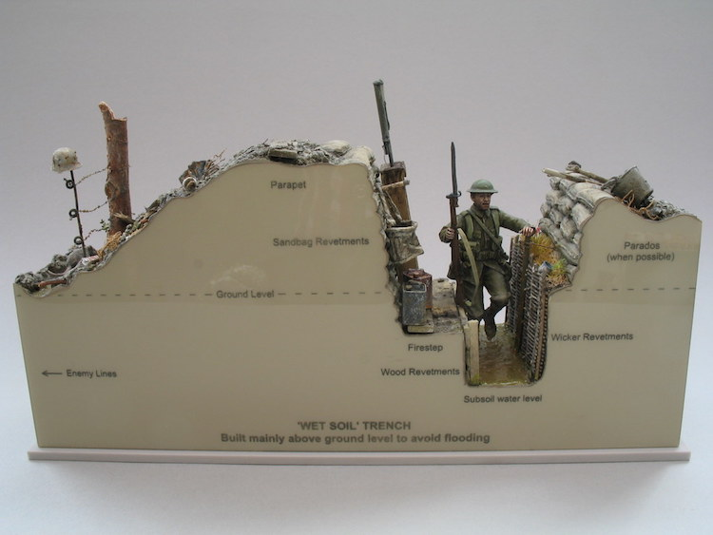
Every Aspect of Military Work is Changing
Skills set going forth:
Computers and communications
Offensive cyber capabilities, systemic networking, quantum computing.
Artificial intelligence and big data.
Projectiles, propulsion
Battery-powered engines and satellites

Slide 18
Every Aspect of Work is Changing
The Culture of Technology bodes well to the disABLED Veterans of Twenty First Century.
The recent pandemic has accelerated technology.
Everything that can go online, will be online.
But keeping the human element in the loop is imperative.
Our Veterans today are more savvy than ever before.

Slide 19
Every Aspect of Work is Changing

Slide 20
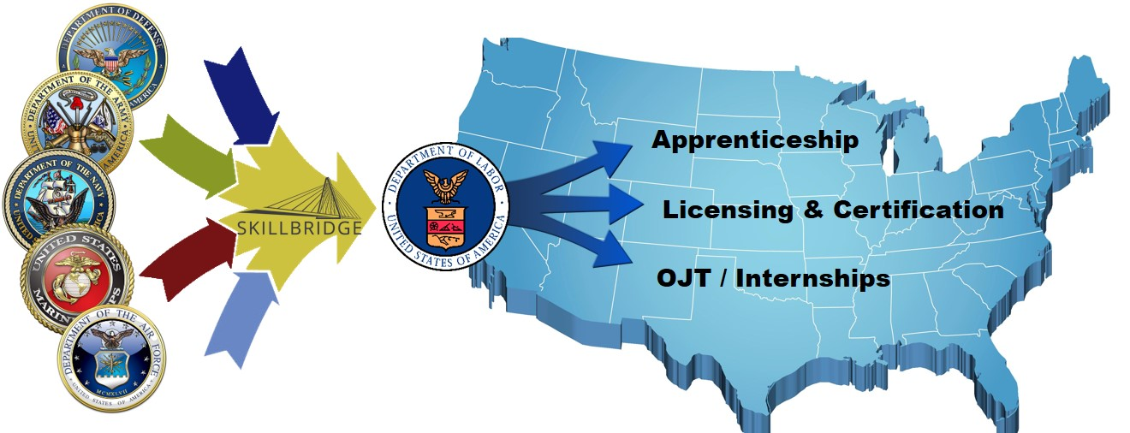
DOD SkillBridge
Through DoD SkillBridge, tremendous potential exists for service members, companies, trade unions, and others to leverage this talent pipeline to meet state, regional, and industry workforce needs.
DoD can use the SkillBridge program to connect to DOL programs already in place and funded to facilitate Transitioning Service Members’ success

Slide 21
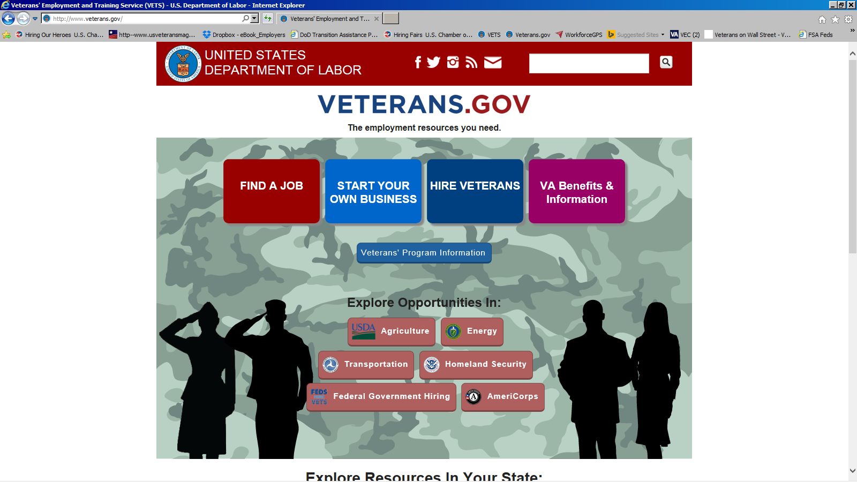
VETERANS.GOV
For Job Seekers:
One-on-One Assistance at AJC
Search career paths
Training programs Colleges and Universities
State and Federal Resources
Explore Online job listings
DOL.GOV/VETERANS

Slide 22
What Can Employers Do To Hire the Veterans They Need?

