Slide 1
WIOA: Title II Adult Education
Katie Madsen
Adult Education State Director
Montana Office of Public Instruction

Slide 2
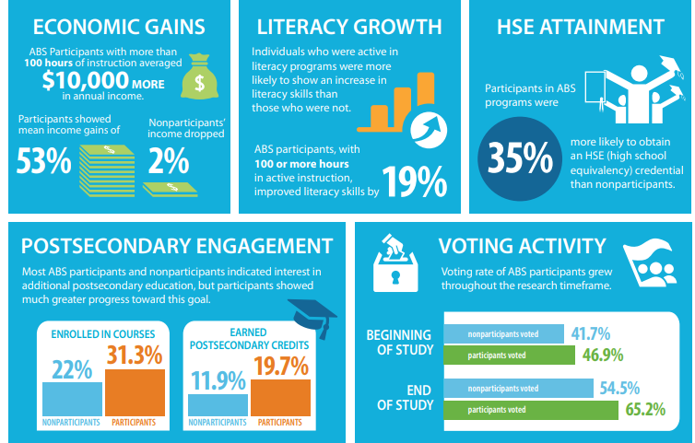
Did you know?
There is a positive correlation between participation in adult education programs and long-term positive outcomes which impact a wide variety of socio-economic issues.
Source: ProLiteracy

Slide 3
General Overview
Adult Education and Family Literacy Act (AEFLA) – WIOA Title II
Administered by the U.S. Department of Education – Office of Career, Technical and Adult Education (OCTAE)
Principal source of federal funding for adult education programs

Slide 4
Program Purpose
Per WIOA [§463.1], the purpose of Adult Education (AE) is to create a partnership between the Federal Government, States, and localities to provide adult education activities in order to:
1. assist adults to become literate and obtain the knowledge and skills necessary for employment and economic self-sufficiency;
2. assist adults who are parents or family members to obtain the education and skills that—
are necessary to becoming full partners in the educational development of their children; and
lead to sustainable improvements in the economic opportunities for their family;
3. assist adults in attaining a secondary school diploma and in the transition to postsecondary education and training, including through career pathways; and
4. assist immigrants and other individuals who are English language learners in—
improving their—
reading, writing, speaking, and comprehension skills in English; and
mathematics skills; and
acquiring an understanding of the American system of Government, individual freedom, and the responsibilities of citizenship.

Slide 5
Program Purpose
In short, the purpose of WIOA Title II Adult Education is to help qualifying individuals prepare for the HiSET (high school equivalency exam – formerly the GED), postsecondary education or training, and the workforce.

Slide 6
Program Eligibility
Adults, 16 years and older, not enrolled in secondary school
Including individuals with diplomas who are low-skilled and under-employed
Basic skills deficient
Test of Adult Basic Education (TABE) – measures academic level upon intake
BEST Plus/BEST Literacy – English Language Learners
**WIOA Title II services are free of charge
for qualifying individuals.**

Slide 7
Program Providers
Per WIOA [§463.23], an organization that has demonstrated effectiveness in providing adult education and literacy activities is eligible to apply for grant funds.
The Office of Public Instruction (OPI) awards multi-year grants on a competitive basis.
Most recent RFP process completed – Spring 2022
WIOA Title II Grant Award for PY 22 (July 1, 2022-June 30, 2023) - $1,360,620

Slide 8
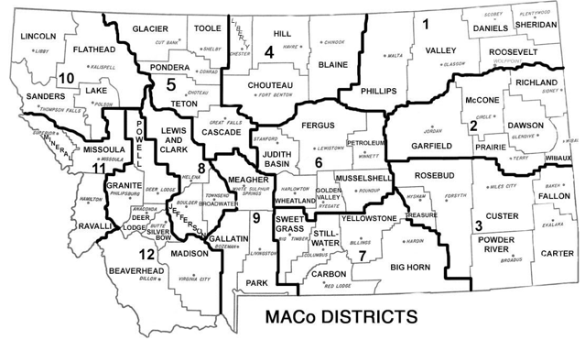
Program Providers
The OPI oversees the adult education programs in the state that receive WIOA federal funding.
12 WIOA Title II Providers

Slide 9
Program Funding
Initial federal allocation for each state is $250,000. To calculate the allotments in addition to the initial allocation, the U.S. Department of Education uses census data from the American Community Survey (ACS) 1-year estimates.
Federal statute requires states to allocate no less than 82.5% of their allotments to local agencies through a competitive grant or contract process.
PY 2021 WIOA Title II federal funding allocation to local programs: $1,177,699
Montana utilizes a state-imposed funding formula, consisting of need and performance-based measures, to allocate WIOA Title II funds. This funding formula currently includes components such as program enrollment, poverty, unemployment, dropout rate, educational functioning level gains, HSE attainment, state targets achieved, posttest rate, IET participants, and program engagement.

Slide 10
Program Funding
PY 2021 (July 1, 2021-June 30, 2022) allocations awarded to WIOA Title II providers are listed below.
Regional Area Served | State Funds Awarded | Federal Funds Awarded | MOE/Local Match Requirement
MACO Districts 1-2 | $12,783 | $35,304 | $20,800
MACO District 3 | $14,919 | $29,560 | $19,239
MACO District 4 | $23,003 | $45,579 | $29,665
MACO District 5 | $96,055 | $190,325 | $123,873
MACO District 6 | $10,378 | $20,563 | $13,383
MACO District 7 | $120,680 | $239,115 | $155,628
MACO District 8 | $29,539 | $58,530 | $38,094
MACO District 9 | $24,453 | $48,453 | $31,535
MACO District 10 | $59,932 | $118,751 | $77,289
MACO District 11 | $108,574 | $215,131 | $140,017
MACO District 12 | $24,684 | $48,910 | $31,833
Corrections Education | N/A | $77,978 | $33,729
Integrated English Literacy and Civics Education | N/A | $49,500 | N/A
Total | $525,000 (State General Fund) | $1,177,699 (WIOA Title II) | $715,085

Slide 11
Integrated Education and Training
Integrated Education and Training (IET) is a service approach that provides adult education and literacy activities concurrently and contextually with workforce preparation activities and workforce training for a specific occupation or occupational cluster for the purpose of educational and career advancement (§463.35).
An IET program must include the following three components: adult education and literacy activities, workforce preparation activities, and workforce training (§463.36).
As part of a career pathway (§463.37), the design of an IET program should support the local and state workforce development board plans as required under WIOA.
All IET programs should align with state and regional labor market needs to assist individuals with relative career pathways, specialized training, and employment opportunities.

Slide 12
Partnership Opportunities
Employer engagement and collaboration is key.
Current IET programs in various stages of development:
Flathead Valley – Construction, Healthcare, Hospitality and Tourism
Great Falls – CNA, CDL
Missoula – CNA, Hospitality, Entrepreneurship
Billings – Medical Assistant, Dental Assistant, Phlebotomy
Montana Department of Corrections – Automotive Pre-Apprenticeship
IET programs are an opportunity for the SWIB and local business/industry to partner with WIOA Adult Education Programs.

Slide 13
Partnership Considerations to ponder
Are there other WIOA funding opportunities available to support the development of these IET programs that provide dedicated workforce preparation for Montana’s future pipeline?
Possibility of braiding funding streams with other WIOA Titles?

Slide 14
Program Highlights
During the 2021-2022 program year, WIOA Adult Education Programs in Montana collectively:
Served over 2000 adult learners – ages 16-60+.
The largest age group served was 25-44.
Helped approximately 400 adult learners increase their academic preparedness level and enter postsecondary education or specialized training.
Assisted approximately 500 adult learners to prepare for and obtain a high school equivalency diploma (HiSET).
Provided over 700 adult learners with integrated education and training (IET) opportunities aligned with specific career pathways.

Slide 15
Success stories
The AE Program located in Great Falls, (College and Career Readiness Center), recently had eleven students that successfully completed the CNA program. Also, five CDL students obtained their permit and are doing behind-the-wheel training.

Slide 16
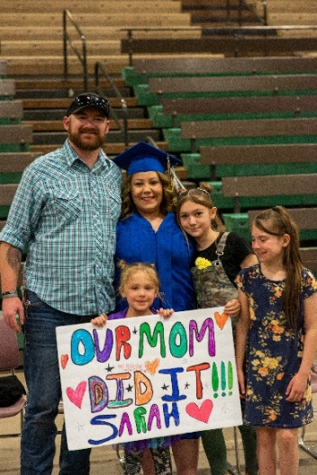
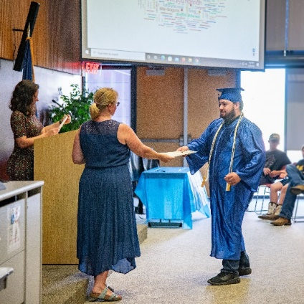
Success stories
The AE Programs located in Lewistown and Glendive, (HRDC 6 Adult Education and Dawson Community College Adult Education), recently reported an uptick in HiSET completers. All WIOA Adult Education Programs, large and small, excel at helping prepare adult learners to successfully complete the HiSET. Programs provide both in-person and virtual instruction – which is often tailored to fit the needs of the individual.

Slide 17
Success stories
The AE Program located in Kalispell, (FVCC Adult Education), recently unveiled a virtual reality (VR) construction training option for their students to utilize.

Slide 18
Questions?
Katie Madsen
Adult Education State Director
HiSET State Administrator
Montana Office of Public Instruction
Katie.Madsen@mt.gov

