Slide 1
Nick Holom,
Senior Economist
Workforce Services Division
October
2022
Notes:
Largest layoff in Montana’s history
To the tightest labor markets we’ve ever experienced.

Slide 2
Real GDP Growth since 2009
United States
Montana
Source: Bureau of Economic Analysis (BEA)
Notes:
This chart shows Montana’s GDP growth year over year, and GDP-- if you’re unfamiliar is the market value of total production of goods and services in Montana’s economy.
US 2009-2019 average 2.2%
Putting it into real terms just means we’re accounting for differences in prices to get at whether the true value of our production actually increased.
Montana’s real GDP (or GDP after accounting for changes in prices) grew in 2021.
Grew at it’s fastest rate since 1980 (though partially because we’re climbing out of a hole).
However you’ll notice we didn’t lose as much in 2020 was the rest of the U.S.
Grew faster than it did in the U.S. Overall Montana’s GDP has recovered as of the first quarter of last year. I think we largely have a lot of pandemic programs to thank for that.
US is 5.7%

Slide 3
Real GDP Growth since 2009
Montana
2009-2019 Average = 1.7%
Source: Bureau of Economic Analysis (BEA). Growth rate is Compounding Annual Growth Rate (CAGR)
Notes:
US 2009-2019 average 2.2%
2016- losses in energy sector of about $1.4 b combined. but slowdowns in 2018 and 2019

Slide 4
Real GDP Growth since 2009
United States
Montana
Montana in 2021
Ranked 7th for GDP growth
Fastest GDP growth since 1980
Source: Bureau of Economic Analysis (BEA).
Notes:
US is 5.7%

Slide 5
Rapid Employment Growth in 2021
United States
Montana
More Montana jobs added in 2021 than any other year back to 1976
(when data begins)
Source: Local Area Unemployment Statistics (LAUS), MTDLI and BLS
Notes:
In 2021, we recovered our pre-recession level of employment by about the middle of the year.
YOY growth as a percent was faster than in any other year all the way back to 1976 (again partially because we’re climbing out of the hole that 2020 left us in.
But compared to the U.S. we had faster growth (3.8% compared to 3%)
We also had less of a hole than the U.S. in 2020. We lost only about 2% of employment for the year compared to 6% for the U.S.

Slide 6
Employment Growth High, Real Wage Growth Mixed
Source: Real payroll wages from QCEW and employment from LAUS

Slide 7
Reservation Employment Performance Mixed
Source: LAUS 2019-2022. Annual average 2022 includes data as of June 2022.

Slide 8
All Industries Recovered Or Close To It Payroll Jobs in Select Industry Compared to Feb 2020
All Industries At Or Above Pre-Pandemic Employment
Change from Pre-Recession Peak
Professional & Business Services – 10%
Construction – 8%
Trade, Trans. & Utilities – 5%
Leisure Activities – 5%
Mining – 0%
Health Care – 2%
Source: lmi.mt.gov/home/job-tracking CES, MTDLI
Notes:
The “other” sector is still a bit down. Auto shops, nonprofits, childcare centers.

Slide 9
Personal Income by Component MT #1 in Personal Income Growth 2019-2020
Wages & Supplements
Dividends, Interest, & Rent
Government Transfers
Business Owner Income
Source: Personal Income, Bureau of Economic Analysis.
Notes:
Consists of employer contributions for employee pension and insurance funds and employer contributions for government social insurance.

Slide 10
Average Wage Growth 10th in Nation
Source: US BLS and Montana Dept. of Labor and Industry, QCEW and CPI-U
Notes:
This shows the average annual wage growth in payroll wages, and Montana, compared to other states. The bars correspond to the right side while the line shows our YOY percent of growth in real wages.
We had really strong growth in average wages in 2020. Partially that is due to the fact that most layoffs were of lower wage workers—so that brings up the average, but even with those layoffs there was growth in total wages, so it wasn’t all due to a change in composition.
Into 2020, our average wage grew by about 3500 another and in 2021 it grew by another 2,900 or so. And this is with recovery of our previous levels of employment and really low unemployment which results in those wages getting competed upward.
So even with high inflation over this time period (I think close to 4.7%) we had growth in average wages that was faster than inflation.

Slide 11
Inflation Cuts into Wage Gains
Notes:
Economists use the CPI to adjust prices, which is really a measure that takes a basket of goods that’s meant to reflect the purchases of the average consumer, and they’re keeping that basket of goods constant year to year and measures the cost of that basket of goods. So assuming consumers consume the same goods—what is the price increase.
When we talk about real wages, we use a price index that takes into account price changes, and adjust wages accordingly. Its really just trying to put those wages into an apples to apples comparison so we can see if people can now purchase more with their wages or less with their wages.
A few things about CPI
It’s a measure of national changes in prices, so if prices didn’t change as much or changed differently in the state of Montana,Montanans, we could be better or worse off.
We also may be worse off if we consume differently than “the average consumer”.
There are a few ways Montanans may be worse off
1 we have faster growing housing prices. The consumer price index actually only captures rent and prices of homes—which we’ll see later have increased substantially.
And there are other ways Montanas consume differently, for example, we drive more.
So in this chart we see the cost of energy is 40% higher a lot of that is driven by gas, which may mean Montanans are hurting more from gas prices.

Slide 12
54% Increase in Median Home Prices Since 2015
Source: Census Bureau American Community Survey 2021 1-Year Estimates.
Notes:
Compared to 2015 we had median home prices increase by more than 54% across Montana. Montana’s household income has increased by only 28% over that time period.
Montana’s population increased by 10% from 2010 to 2020 while it’s housing units increased by only 7%.
We all know housing is an issue—and thanks to all the non-profits that are working to get more affordable housing in our communities.

Slide 13
Net Migration by County April 2020 to July 2021 = 22,000 people total
2010-2019 average: 6,200
Source: 2022 Labor Day Report. https://lmi.mt.gov/_docs/Publications/LMI-Pubs/Labor-Market-Publications/LDR20221.pdf

Slide 14
Rapid Growth in New Establishments
Source: BLS Business Employment Dynamics, age and size tables. Total establishments from QCEW. The Economic Contribution of Entrepreneurship in Montana. https://lmi.mt.gov/_docs/Publications/EAG-Articles/0622-EntrepreneurshipMT.pdf

Slide 15
More Workers Than Ever Before
Population: ~42,600 more people (16 and up)
than pre-pandemic
Also…More People
Labor Force ~20,200 more people than pre-pandemic
~550,000 People Employed
Employment: ~24,400 more people
than pre-pandemic
Source: LAUS, MTDLI.
Notes:
With any shortage there’s a supply side and demand side.
Do we have fewer workers than before
Do we have more population demanding services.
The answer is that we have more workers working or available for work than ever before.
But we also have more people.
The difference between the blue line and the black line are unemployed people

Slide 16
Unemployment Rate Near Record Lows
2.7%
Source: CPS and LAUS, BLS & MTDLI
Notes:
The share of the labor force that is composed of available workers—workers not already attached to an employer is the unemployment rates
it gets a lot of focus
it’s a measure of how easy it is to find a job, or conversely how difficult it is to find a loose worker
It’s starting to tick up a little but it’s at a historic low, which means employers have to either compete workers away from other employers—driving up wages and improving other benefits for workers, or they have to make due with the workers available

Slide 17
Job Openings Are Much Higher
Elevated Job Openings Compared to Pre-Pandemic
More Consumer Demand = More Demand for Workers
Source: lmi.mt.gov/home/job-tracking JOLTS, MTDLI
Notes:
We have most of the Montanans who can work are available for work, however, as there has continued to be strong consumer demand,
employers want to hire more workers, but those workers don’t exist, so this green line shows the number of unfilled job openings at the end of each month has remained way above pre-pandemic levels at roughly 45,000 in July
30,000 hires in the month of May, but unfilled job openings which is a measure of the unfilled jobs that remain open at the end of the month continues to climb.
Across states, Montana has the 4th highest rate of job openings per employment and 4th highest rate of hires, so we have more openings as a share of employment but also are hiring more people as a share of employment.

Slide 18
Quits Up, Hires Up, Layoffs Down
Quits Elevated as Workers Seek Better Opportunities
Source: lmi.mt.gov/home/job-tracking JOLTS, MTDLI
Notes:
We hear a lot about the great resignation, many workers having an opportunity to quit their jobs, potentially to move into better paying jobs, or jobs that work better with their schedule or their at home responsibilities.
As employers try to hold to the workers they can, we see layoffs and discharges are at or below the levels they were prior to the pandemic. At the same time, employers are competing over workers, so those workers who quit voluntarily, potentially to pursue a new job, potentially to retire, has continued to be a level above the pre-pandemic level.
6th highest rate of quits

Slide 19
Almost 3 Job Openings For Every Person!
Now We Have 2.7 Jobs Per Person
Pre-Pandemic We Had 1.4 Jobs Per Person
Job Openings
Source: Bureau of Labor Statistics JOLTS and LAUS Jan 2003 to Jun 2022. Unemployment is rounded to the nearest hundred.
Notes:
this just shows that level of available workers versus the number of job openings
We can see that even pre-pandemic we had 1.4 jobs per person
Post we rose to nearly 3 available jobs per person.
So our labor markets are really out of wack and there’s a big disparity between supply and demand
But that mismatch or openings outstripping employed people starting before the pandemic.

Slide 20
Retirements on the Rise
Baby Boomers Hit Retirement Age
Other Reasons Remain Level Despite Increasing Population
Source: IPUMS Current Population Survey, Jan 1994-July 2022. Twelve-month moving averages, rounded to the nearest thousand.
.
Notes:
that’s because of this chart
This shows people not in the labor force by main activity.
We can see that retirements have always been the biggest reason that’s changing over the period. Increased by 50,000 people in the past 10 years
As far as a solution to the labor shortage there’s really two options—
Increase your engagement of these potential workers
Or Increase productivity—that is invest in labor saving tech, better training for workers, or rethinking your workplace.
School attendance – This is the main reason provided by 77% of people ages 15-25. Most young people are still making an investment in their human capital, which if their bet pays off improves their long-term earning potential and improves their productivity in the long-term. The downside is that means fewer workers as those investments are made, so potentially a solution could be to try and create opportunities to engage these people at least in part-time work or internships could be one way to incorporate more of these workers.
Illness/disability –There is a pool of potential workers who could work but need accommodation for their disability in order to work. Potentially as employers are strapped for workers, more attention could be paid to accommodating these workers and finding ways to employ more of them.
Family care – This breaks down into childcare and elder care. As we get more of the population retiring, that potentially puts more of strain on people of working age if they’re called on to care for their elderly parents. On the childcare side of things, in Montana, even prior to the pandemic, we had a shortage of childcare services. We also conducted a survey of businesses in the first quarter of 2020 and over half of businesses in every region of the state reported a lack of affordable childcare as an issue that affects their ability to recruit.

Slide 21
Montana Labor Force Participation Rate
Source: CPS and LAUS, BLS & MTDLI
Notes:
So one metric economist use to understand labor supply in the context of population growth is the the Labor Force Participation Rate.
The labor force participation rate is the share of the working age population that is working or available for work. So although Montana is working with a bigger labor force, the population is also growing through time. The share of our labor force that is participating is actually lower than it was in the 90s and 2000s. If we wanted to get it back to the levels it was at 1990’s to 2000s which was about 66% of the working age population.
With any recession, participation in the labor force drops, because people get laid off, they get discouraged, they stop looking for work. But what we saw with the 2009 recession, was people stopped participating and then never came back. Most of that is due I think to coinciding with the baby boomers hitting retirement age, so we never really recovered back to previous participation levels.

Slide 22
Labor Force Participation by Age: Most above pre-pandemic levels
Up 0.4%
People move from here to here.
Up 1.7%
Up 1.3%
Lmi.mt.gov/home/job-tracking, Current Population Survey, complied by MTDLI
Notes:
When we look at participation by age group, this is the share of the population in each age group that are working or available for work we see that none of them are having huge changes.
Going from top to bottom we 85% of people in their prime working years
Then as people hit 55-65, they start to retire early, they start to have more illness/disability that keeps them out of the labor market.
Young people—they’ve actually been on an upward trend for a little bit, that coincides with wage gains among those lower wage occupations that young inexperience workers tend to work. They had a drop off with the pandemic—because they tend to work in those industries most affected such as food service. But they’re back above prepandemic levels.
65 and up have mostly remained at about 20% participating.

Slide 23
Absenteeism Still Elevated
Source: IPUMS CPS. Montana, 12-month averages.
Notes:
There is also increased absenteeism—so these are people who are employed but were absent in the previous week. So on average Montana has about 5,000 more workers absent per week on average than they did prior to covid.
What are some of the reasons:
Some may be making up for lost vacation time, though that actually is pretty much in line with previous years.
We had absences due to other which I think was in part due to temporary closures in 2020, but it still remains a little bit higher.
People who were ill or absent for a medical reason is still elevated and we have on average about 6,000 people per week.
When we look at parental leave and family obligation there was a little bump, but really not a super big change which may just mean that they’re not absent for the entire week, and we’ll see later that parents continue working reduced hours.

Slide 24
More People Not Working Due to COVID
Source: Census Bureau HH Pulse Survey and CDC COVID 19 case counts Montana.
Notes:
This actually surprised me when I pulled the data and maybe it shouldn’t, but covid cases are set to be higher this year than they were last year according to the CDC. So covid still remains a stress on our populations and workplace.
Putting that side by side with some of the data from the household pulse survey—which if you’re unfamiliar is an experimental survey that’s conducted through text and email—I’ve actually taken it twice now, but it asks some questions that we usually don’t get a lot of good timely data on and one of those is how many people are not working because they’re caring for or sick themselves with COVID. That estimate places that number at about 8,600 people on average during the year—which is higher than it was in 2021. I will say these estimates have large error ranges, but on average that seems to still be a rising number not a falling number.
There seems to be some evidence too of long-covid keeping about 4 million workers nationwide out of the labor force, so I think the covid may be continuing to contribute to that tightness.

Slide 25
Parents Working Fewer Hours Per Week
Parents
9,600 Fewer FTEs
Source: IPUMS Current Population Survey 1994-2022, 12-Month Moving Average.

Slide 26
Accommodate Disabilities
Source: IPUMS Current Population Survey, 12-month moving average.
Notes:
That keeps about 42,000 people out of the labor force at least in the most recent twelve months of data.
When we look at these groups, most are struggling with walking or mobility—so accommodating disabilities could help employers tap into more of these workers.
In addition, remote work could be a solution for those who have limited mobility, it may be easier to bring work opportunities to them.
The state of Montana does have a service through DPHHS’s vocational rehab program that offers career counseling, training, job development and placement, identify and obtain adaptive aids or equipment necessary to help you get or keep a job.

Slide 27
Main Challenges for Workers
Source: MTDLI & Federal Reserve Worker Experience Survey August 2021
Notes:
Correctional Enterprises Inmate Job Fair hosted by the Montana Department of Corrections (DOC) and the Montana Department of Labor & Industry (DLI).

Slide 28
Main Takeaways for Montana’s Labor Market
Demand for Workers
Positive economic shock & rapid growth
High turnover rates as workers seek out better jobs
High migration from out of state
Supply of Workers
Aging workforce increasing the share of the population in retirement
Illness & COVID results in fewer workers and hours available
Reduced hours from childcare issues
High migration from out of state
Potential competition from remote employers

Slide 29
What Can We Do?
Make it easier and more attractive to work
Better work/life balance
More flexibility
Remote/hybrid work
Tackle big issues
Housing
Childcare
Increase wages
Provide training
Invest in better technology
What Groups Can Employers Target?
Retirees
Those with a disability
Parents
Students
Those with background issues

Slide 30
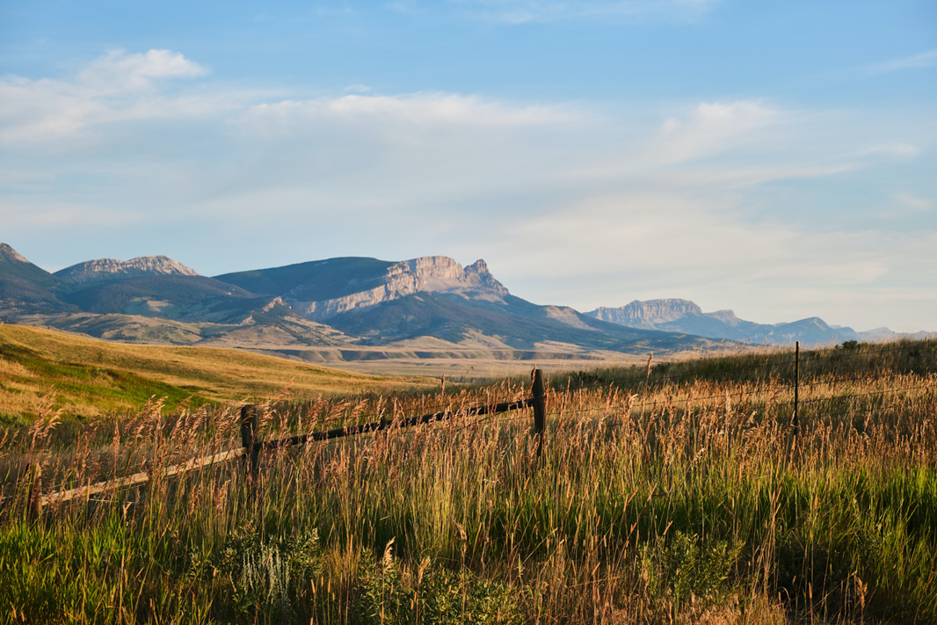
More Information at lmi.mt.gov
Nick Holom
MT Dept. of Labor & Industry
Nicholas.holom@mt.gov

