Slide 1
Perkins State Plan Renewal
Jacque Treaster
Director of Dual Enrollment and Career & Technical Education

Slide 2
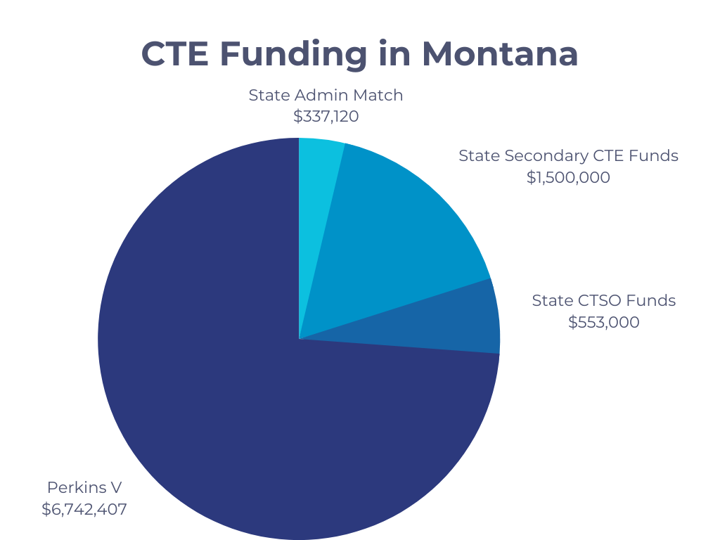

Slide 3
2024 Perkins V State Plan
Statewide vision for CTE and the Workforce Development System in Montana
Alignment between secondary postsecondary workforce
Statewide strategies to support the recruitment and preparation of CTE instructors, including professional development
Strategies and activities to support work-based learning
Review and revise data performance indicators

Slide 4
Timeline
September/October 2023 – Perkins Stakeholder Survey
October 2023 – Data Review for State Determined Levels of Performance
November 2023 – First Perkins State Plan Committee Meeting & Board of Regents Update
December 2023 – Governor’s Office Consultation
January 2024 – State Agency Leadership Consultation
February 2024 – Public Hearings
March 2024 – 60-Day Public Comment & Board of Regents Approval of State Plan
May 10, 2024 – Submission of State Plan

Slide 5
Required Stakeholder Consultation
Community College and Postsecondary CTE Leadership
Tribal College Leadership
Adult CTE Providers
Secondary and Postsecondary CTE Teachers/Faculty
Representatives of the State workforce development board
Parents, students, interested community organizations
Members and representatives of Special Populations
Representatives of Business and Industry, which include industry and sector partnerships and representatives of labor organizations
State Coordinator for Homeless Children and Youth
Representatives of Indian Tribes and Tribal Organizations
Individuals with disabilities

Slide 6
Perkins State Plan Survey

Slide 7
Contact for More Information
Jacque Treaster
jtreaster@montana.edu
(406) 449-9135

