Slide 1
Jobs for Montana’s Graduates
Erica Swanson- State Director
eswanson@mt.gov
406.444.0978

Slide 2
WHAT is Jobs for Montana’s Graduates?
Model that develops students' essential skills needed for the workforce

Slide 3
Foundations
Project Based Learning
Trauma Informed Care
Employer Engagement
Students learn by actively engaging in real-world and personally meaningful projects.
Practices that promote a culture of safety, empowerment, and healing.
Engages employers in the classroom as well as in the professional setting to expose students to job opportunities and career pathways in their own communities.

Slide 4
How this looks in a Classroom
Connectivity to School and Community
Students are allowed foster belonging and a safe place to try new things
Students learn leadership with a hands-on approach
Guided learning to incorporate what student are interested in

Slide 5
IMPACT of Jobs for Montana’s Graduates
Total number of students served 21-22 School Year | 1100
Seniors | 300
Graduation Rate | 95%
Employment | 94%
Post Secondary | 35%

Slide 6
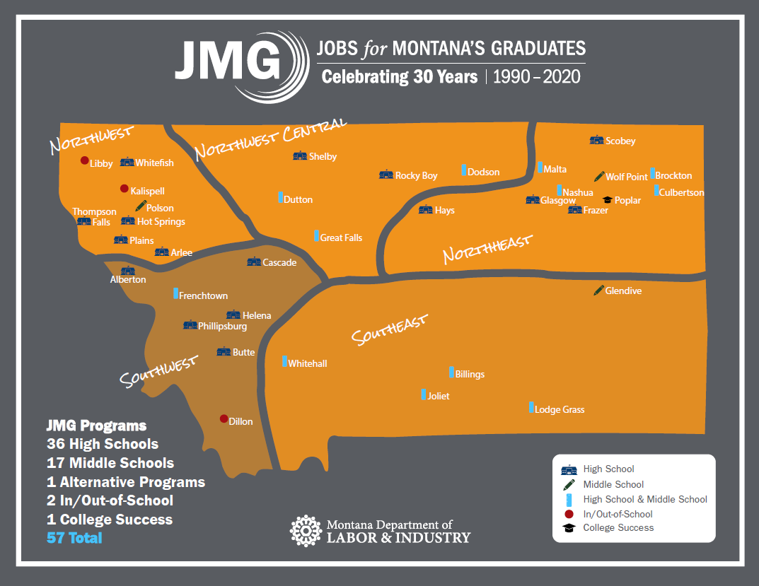
Graduation Rate 95%
Where We Are

Slide 7
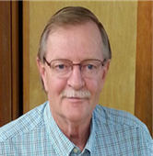
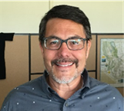
Thank You!
Heather Merritt,
Program Manager
Randy Holm,
Program Manager
James Benjamin,
Program Manager
Erica Swanson,
State Director
Jobs for Montana’s Graduates
eswanson@mt.gov
(406) 444-0978
Helena, MT
Greg Cano,
Program Manager
Christopher Facundo,
Program Manager
Kirsten Geiger,
Program Manager

