Slide 1
Montana Postsecondary Workforce Report
Prepared for the State Workforce Innovation Board October 2022
AMY WATSON, Interim State Economist
Workforce Services Division
awatson@mt.gov | 406-444-3245

Slide 2
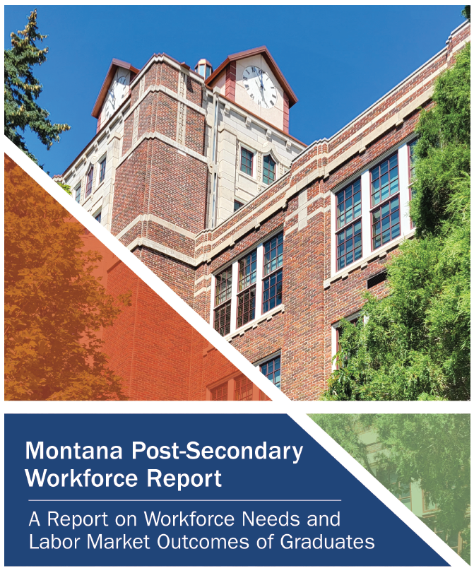
Statewide College Report- Update
Initial report published in 2017
Update released Oct 2022
Research topics include:
Graduate workforce outcomes
Supply and Demand Analysis

Slide 3
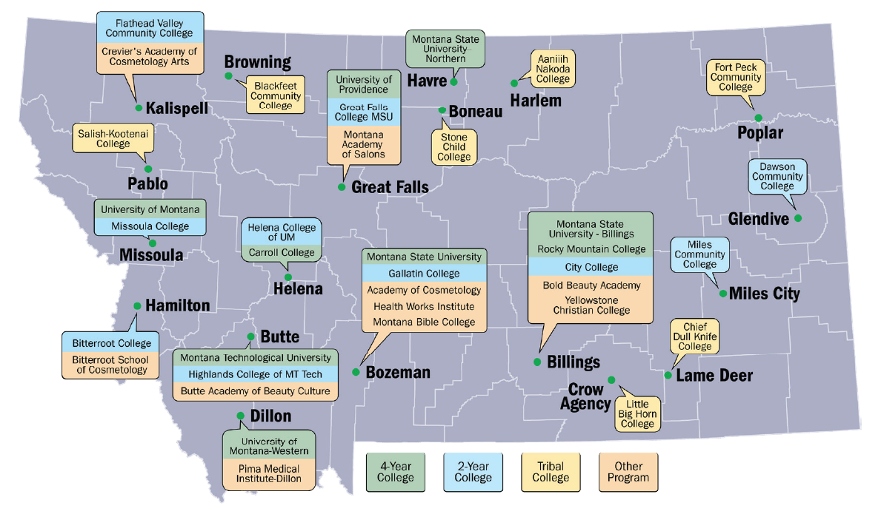
Post-Secondary Education System
Graduates from
2001-02 to 2019-20
~ 145,000 graduates
~ 170,000 degrees
36 Montana post-secondary institutions*
Source: 2022 MTDLI Statewide College Report.
* = Tribal and Vocational programs not included in workforce outcomes

Slide 4
Higher Education System Contribution
11,700
Graduates per year on average
74%
of graduates work in Montana sometime in the ten years after graduation
Graduates work in every county in the state
Source: 2022 MTDLI Statewide College Report.

Slide 5
Graduate Workforce Outcomes
Median Full-Time Earnings
Median Earnings
Source: DOR, OCHE MUS, RMC, CC, UP, and apprenticeship income data match summarized by MTDLI. Income is defined as lines 7, 12, 17, and 18 on the MT income tax return.

Slide 6
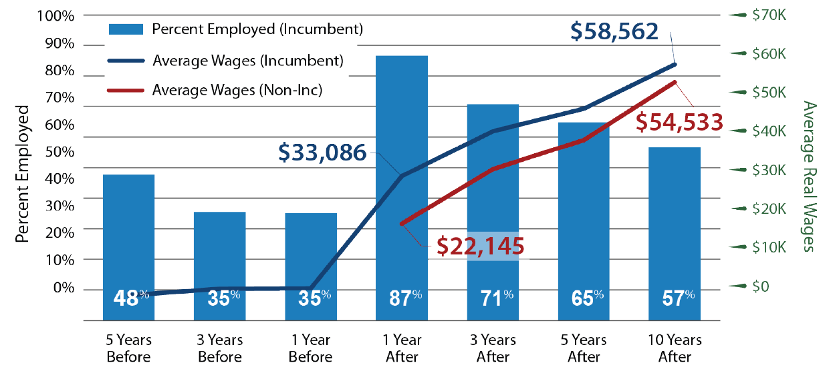
Employers Value Work Experience
56%
of post-secondary graduates have prior
work experience in the MT labor market.
Source: MTDLI, OCHE, RMC, CC, UP, and apprenticeship graduate data wage match. Real wages reported in 2021 dollars using the CPI-U. Incumbent workers were employed at least two quarters per year five years before graduating.

Slide 7
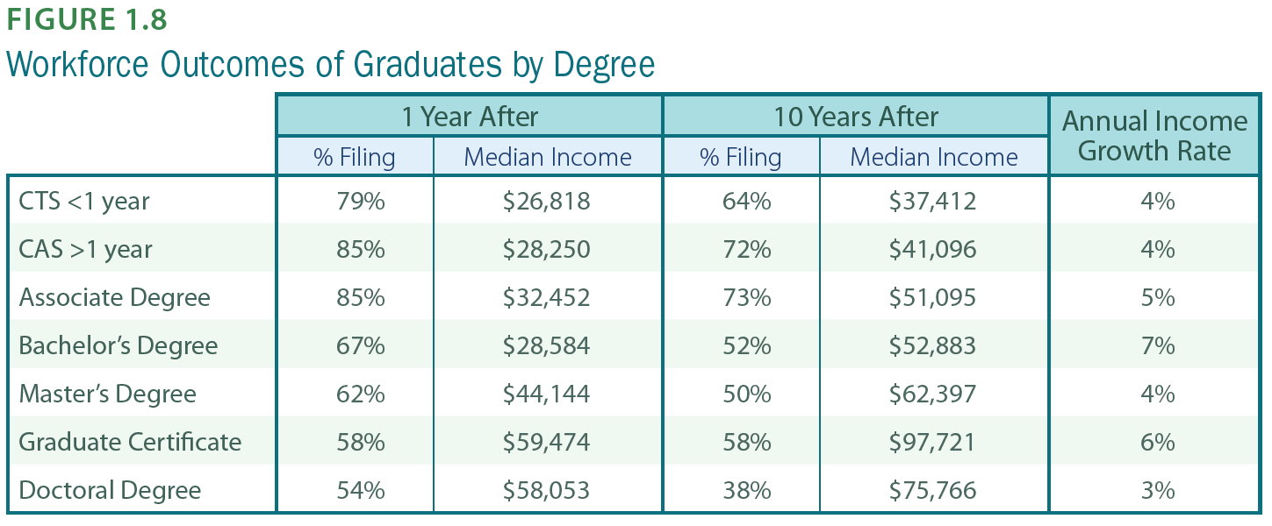
Positive Returns to Higher Ed
Source: MTDLI, OCHE, RMC, CC, UP, and apprenticeship graduate data wage match. Real wages reported in 2021 dollars using the CPI-U. Percent filing resident or non-resident Montana income taxes.

Slide 8
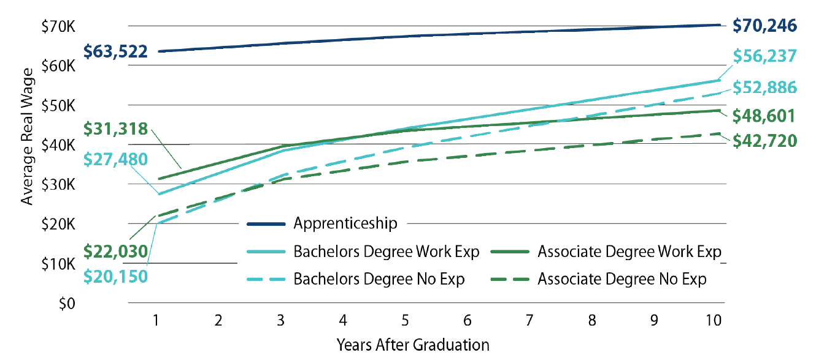
High Earnings for Apprenticeship
Source: MTDLI, OCHE, RMC, CC, UP, and apprenticeship graduate data wage match. Wages reflect average real wages reported in 2021 dollars using the CPI-U. Apprenticeship includes all degree types. Work experience defined as working at least two quarters per year in the five years prior to graduation. All apprenticeship completer have work experience.

Slide 9
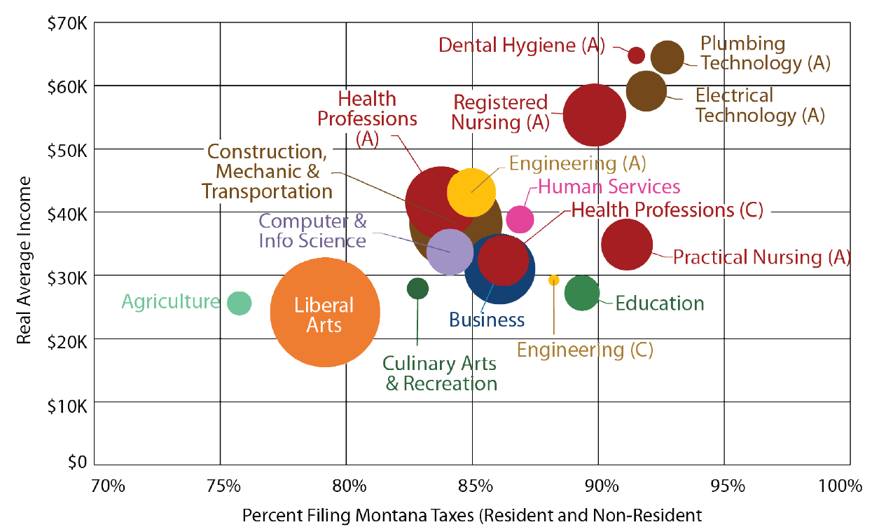
Associate and Certificate Outcomes
One-Year After Graduation
Source: MTDLI, OCHE, RMC, CC, UP, and apprenticeship graduate data wage match. National Student Clearinghouse (NSC) enrollment data.

Slide 10
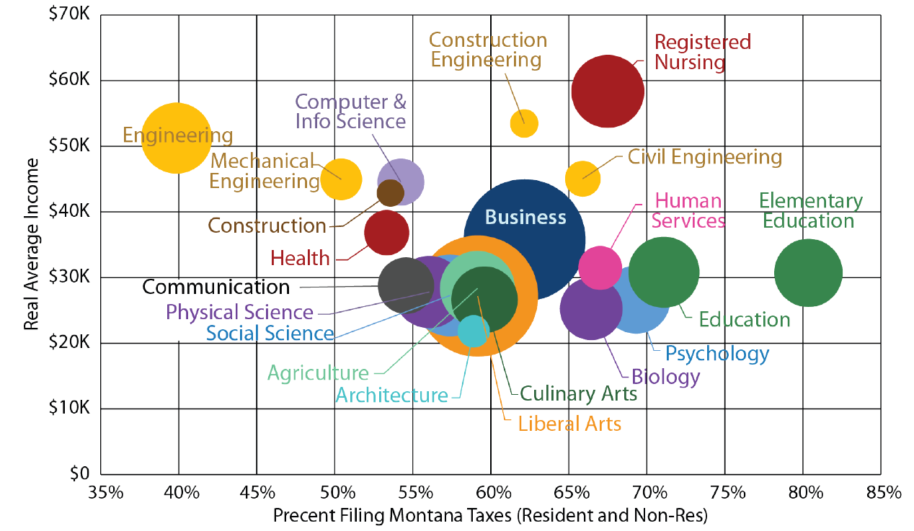
Bachelors Degree Outcomes
One-Year After Graduation
Source: MTDLI, OCHE, RMC, CC, UP, and apprenticeship graduate data wage match. National Student Clearinghouse (NSC) enrollment data.

Slide 11
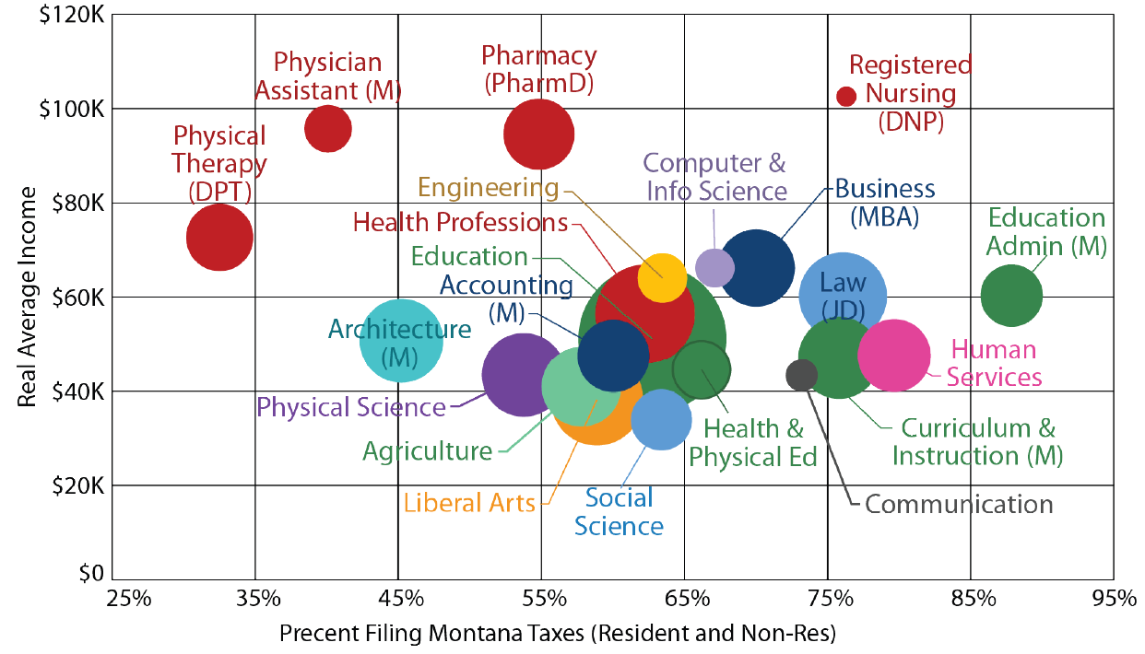
Graduate Degree Outcomes
One-Year After Graduation
Source: MTDLI, OCHE, RMC, CC, UP, and apprenticeship graduate data wage match. National Student Clearinghouse (NSC) enrollment data.

Slide 12
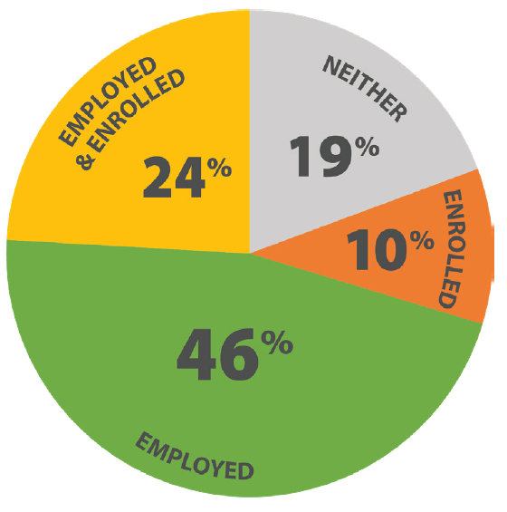
Continuing Education
10% of graduates choose to pursue further education instead of entering the labor market.
24% of graduates choose to pursue further education and enter the labor market.
Most graduates who pursue further education do so in-state.
Those who go out-of-state most commonly go to colleges in the west.
Source: MTDLI, OCHE, RMC, CC, UP, and apprenticeship graduate data wage match. National Student Clearinghouse (NSC) enrollment data.

Slide 13
Review: Workforce Outcomes
Most (75%) students work in Montana after graduation
  34% continue their education
Income above statewide median
  Higher earning for incumbent workers, apprenticeship completers, and select programs.
  Positive returns to higher education
  Are there enough graduates?

Slide 14
Supply and Demand Analysis
How well does the Montana Post-Secondary Education System meet the workforce demand of Montana employers?
Supply of Workers by Program of Study
(Avg Annual Graduates)
Demand for Workers by Occupation
(Annual Job Openings)
Historical Employment Patterns
Source: 2022 MTDLI Statewide College Report.

Slide 15
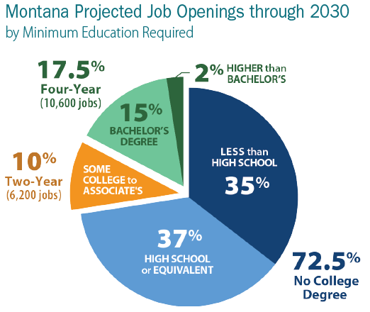
Demand by Occupation
Average number of job openings projected per year through 2030.
Focus on:
High-demand occupations (top 25%)
Occupations requiring college education
Source: MTDLI Employment Projections, 2020-2030

Slide 16
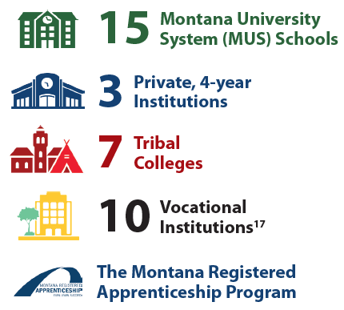
Supply by Program of Study
Average number of graduates per year over the last four academic years from:
Source: 2022 MTDLI Statewide College Report.

Slide 17
New: Historical Employment Patterns
Supply of Graduates
by Program of Study
Supply of Workers
by Occupation
Historical Employment Patterns
Accounts for:
Graduates who move out of state
Graduates who don’t work in field of study
Does not account for:
Graduates who are underemployed
New or emerging occupations
Source: 2022 MTDLI Statewide College Report.

Slide 18
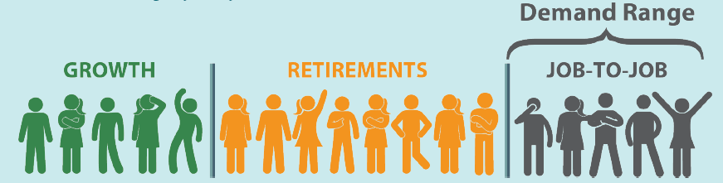
How to “Meet Demand”
Annual supply falls within demand range
  New job growth + retirements
  May need to fill openings from job turnover
Source: 2022 MTDLI Statewide College Report.

Slide 19
Supply and Demand Analysis
62%
of high-demand occupations are undersupplied
  Social Work and Mental Health
  Construction
  Early Childhood Education
  Healthcare Professionals (Graduate-Level)
  Solution: More Graduates?
  It depends…
Source: 2022 MTDLI Statewide College Report.

Slide 20
Why is a Job Undersupplied?
Option 1: There aren’t enough graduates
    Increase post-secondary capacity
Option 2: Graduates pursue different career
    Not a high-wage occupation
Option 3: Graduates leave the state
    Montana not offering competitive wages compared to other states
And more….

Slide 21
Expansion Candidates
Focus on undersupplied, high-wage, high-demand occupations requiring some post-secondary education
High-Wage | Low-Wage
Electrician | Early Childhood Education
Plumbers | Mental Health Counselor
Physical Therapy | Social Work
Physician Assistant | Nursing Assistant
Nurse Practitioner
Software Developer
Source: 2022 MTDLI Statewide College Report.

Slide 22
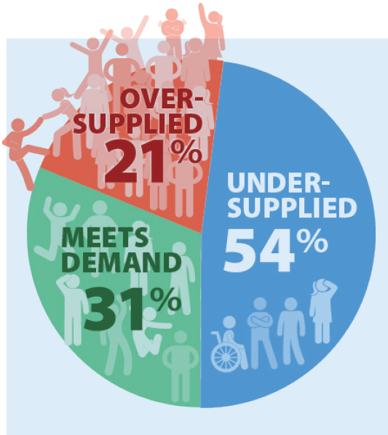
Supply and Demand by Program
11,750 students graduating annually from 85 different programs.
52%
48
of programs are producing enough graduates to meet or exceed future workforce demand.
Source: 2022 MTDLI Statewide College Report.

Slide 23
Undersupplied Programs
Health Science
  Nursing, Physical Therapy, Medical Assistants, Substance Abuse and Addiction Counseling
Education
  Elementary Education, Special Education, Childcare workers (ECE)
Construction
  Electrical, Plumbing, Heavy Equipment Operation
STEM
  Computer and Information Systems
Humanities
  Social Work and Law
Source: 2022 MTDLI Statewide College Report.

Slide 24
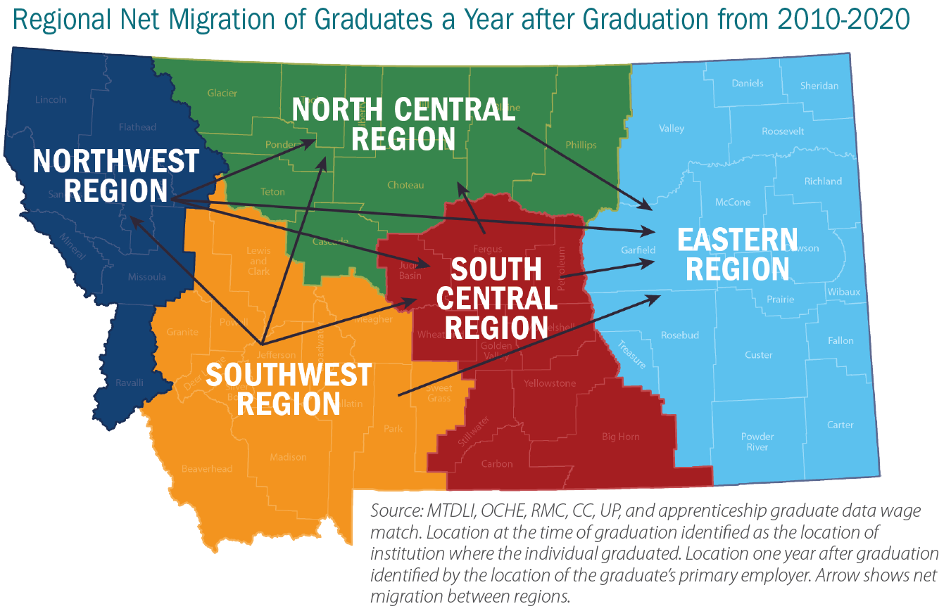
Regional Supply and Demand
Rural areas have the most significant unmet demand.
Only 22% of programs offered in the Eastern Region are meeting employer demand.
In-State migration provides key source of labor supply.

Slide 25
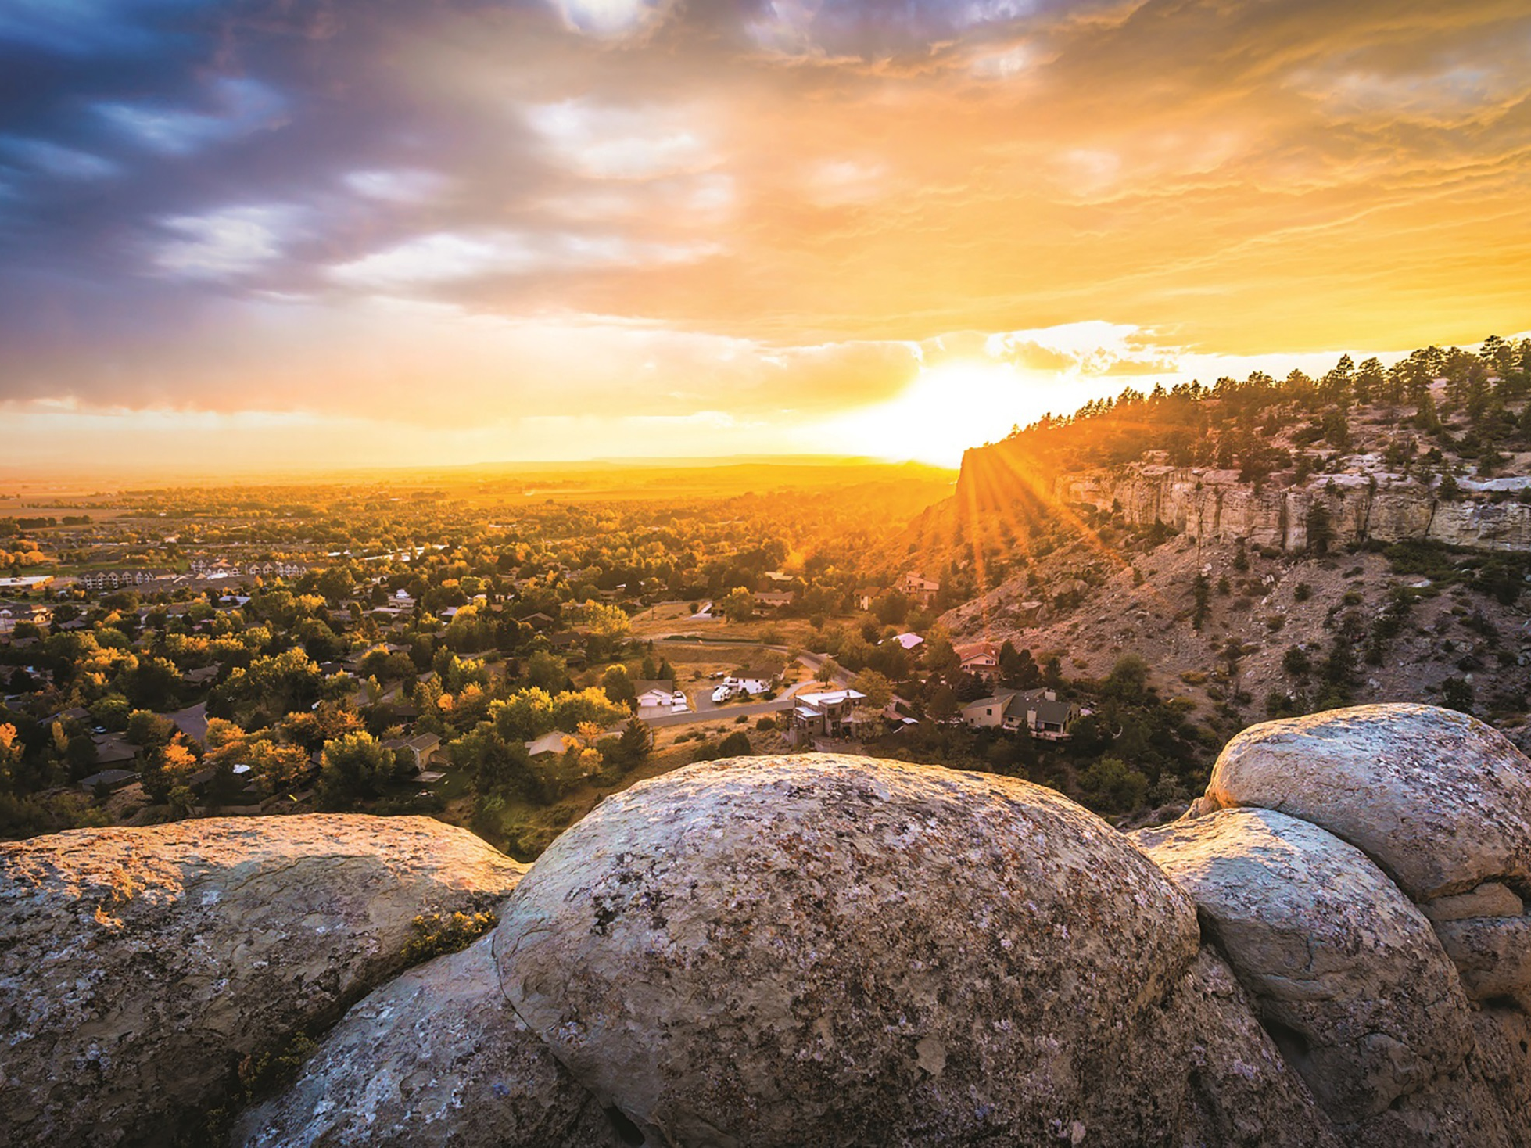
More Information at lmi.mt.gov

