Slide 1
Montana Vocational Rehabilitation and Blind Services
Comprehensive Statewide Needs Assessment
SWIB Presentation
January 31, 2023

Slide 2
Project purpose
Create a CSNA that clearly establishes goals, defines implementation and dissemination plans, gathers and analyzes the information, and provides findings that inform state priorities, strategies, and programming.
Design and disseminate survey instruments that target identified populations and provide reliable and valid measures of population needs.
Assess the rehabilitation needs of individuals with the most significant disabilities, individuals who are minorities, individuals unserved or underserved by VRBS, and individuals with disabilities served through other components of the statewide workforce investment system.
Articulate the needs to establish, develop, or improve community rehabilitation providers within the state.
Provide outreach to stakeholders to assure broad input and establish long-term connections.
Complete a final, professional report and presentation that provides clear findings and is easily accessible to target audiences including the State Rehabilitation Council (SRC) and VRBS Leadership.

Slide 3
Research questions
What is the prevalence of disability in Montana, and how does this context inform VRBS policy and program planning?
What are the rehabilitation needs of people with disabilities in Montana, and how do these vary by geography, population, or other characteristics? Specific populations of interest include:
Individuals with the most significant disabilities, including their need for supported employment services?
Individuals with disabilities who are unserved or underserved, including minorities.
People with:
Deafness or other hearing impairments
Blindness or other visual impairments
Deaf-blindness
Serious or chronic behavioral health issues
Brain injuries
Ambulatory disabilities
Developmental or intellectual disabilities
People with disabilities who are:
Living in rural areas
Racial or ethnic minorities, including American Indians on reservations and in urban settings
Living in migrant communities as well as language minorities
Youth in foster placements
In or transitioning out of institutional or residential settings
Poor/low income
Experiencing homelessness or who are voluntarily transient
Veterans
Youth with disabilities, including students in transition.
Individuals with disabilities served through other components of the statewide workforce investment system, as identified by such individuals and personnel assisting such individuals through the components.
What are the resources VRBS invests in supporting the rehabilitation needs of individuals with disabilities?
What are the outcomes of these investments?
What are the gaps between the needs and resources or client outcomes?
What is the need to establish, develop, or improve community rehabilitation providers in the state?

Slide 4
Assessment data sources and collection methods
Survey
Focus groups
Interviews
Administrative/program data
Population data
Best practices research

Slide 5
CSNA support
Help promote the survey and focus groups to businesses, partners, and interested parties
Participate in interviews, survey, and focus groups

Slide 6
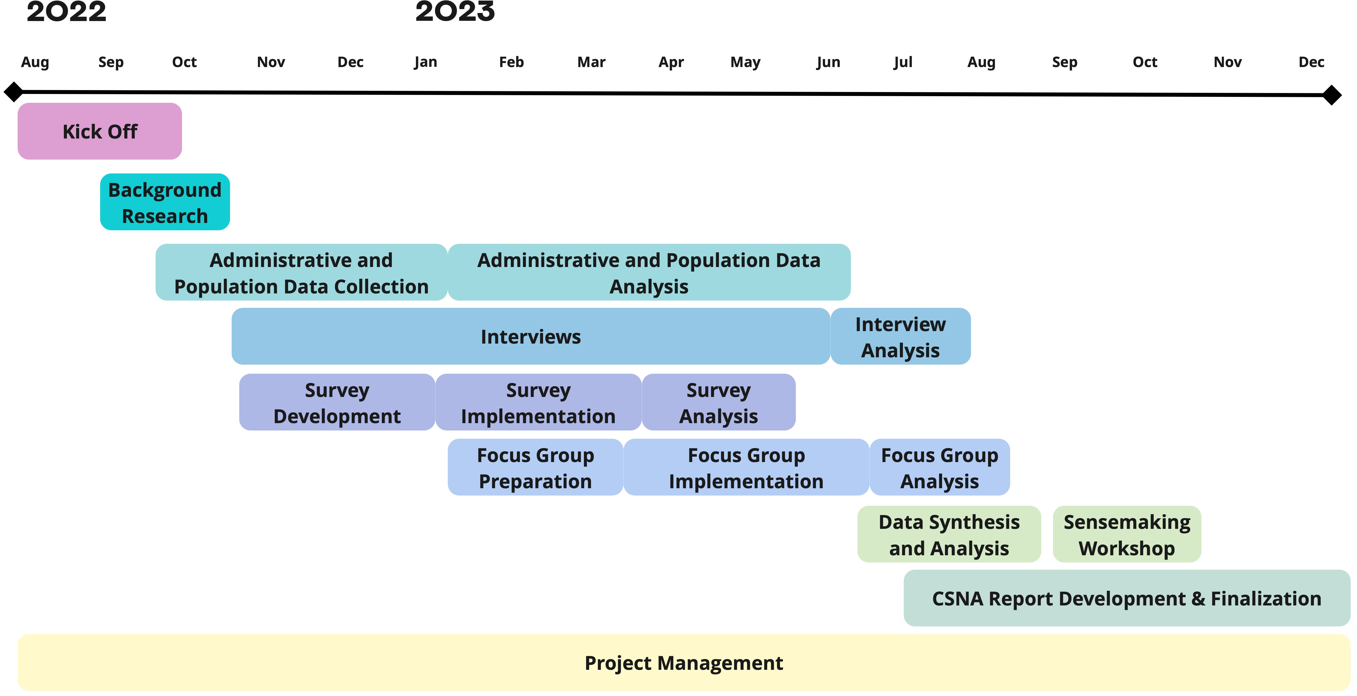
Timeline
Notes:
Consumer satisfaction survey – sent monthly to anyone who exited the previous month. Low response rate.

Slide 7
Questions
Kirsten Smith, ksmith@bloomconsult.org, 406/570.0058

