Slide 1
The Case for Change in Workforce Education
Dylan Klapmeier, governor’s education & workforce policy Advisor
Sarah Swanson, Director of strategic engagement
State Workforce innovation board - April 26, 2022

Slide 2
The Case for Change in Workforce Education
"For far too long Montana has not been living up to its potential. I think this is because there is a longstanding disconnect between employers and educators," Gianforte said. "I'd like to see programs like Accelerate Montana reach every campus in different industries across the state."
Gianforte said Accelerate Montana is expected to train up to 5,000 workers over the next few years, and he expressed enthusiasm that Carroll is a part of the project to "empower students with in-demand skills."
When asked what other major industries need workforce development, Gianforte cited meetings he has had with home builders who lack carpenters, electricians and more. The governor said he met with a Helena manufacturer recently who had 63 open positions. Gianforte also cited his meetings with restaurant industry heads who are experiencing a drought of qualified workers for management positions and more.
According to Gianforte, the goal with projects like Accelerate Montana is to use the educational institutions, public or private, in the state to create industry pipelines to where workers are needed the most.
- Helena Independent Record 2.23.22

Slide 3
Governor Gianforte proclaims FEBRUARY 2022 Cte month
WHEREAS, Career and Technical Education (CTE) provides Montana students unique work-based learning opportunities to prepare for a broad range of high-wage, high-skill, high-demand careers; and
WHEREAS, CTE leads students to career paths that provide family-sustaining wages, provides opportunities for advancement and lifelong learning, and helps address Montana’s workforce needs; and
WHEREAS, the jobs of tomorrow require retraining, as well as targeted technical training, and the forces at work are moving with ever increasing speed; and
WHEREAS, personalized CTE education provides not only the technical skills for occupational advancement but also a vision for the student of what a successful career in the trades can mean for them; and
WHEREAS, local school boards in Montana have the authority to create proficiency and work-based learning paths personalized for each individual student;

Slide 4
Section 1. Educational goals and duties. (1) It is the goal of the people to establish a system of education which will develop the full educational potential of each person. Equality of educational opportunity is guaranteed to each person of the state. (2) The state recognizes the distinct and unique cultural heritage of the American Indians and is committed in its educational goals to the preservation of their cultural integrity. (3) The legislature shall provide a basic system of free quality public elementary and secondary schools. The legislature may provide such other educational institutions, public libraries, and educational programs as it deems desirable. It shall fund and distribute in an equitable manner to the school districts the state's share of the cost of the basic elementary and secondary school system.
Constitution of montana: article x – education and public lands

Slide 5
ARE WE PREPARING ALL MONTANA STUDENTS FOR THE 21ST CENTURY WORKFORCE?
Old work Environment (IBM)
Google Work Environment
Very structured and classroom-like.
A bell rings and you report to your “cell”.
Outcome and proficiency focused. Time and space are variable.

Slide 6
IS THERE A REASON FOR CHANGING EDUCATION?
Automotive Tech of yesterday
Automotive Tech Today
No computerization. Good work could get done with basic tools and general mechanical reasoning skills.
The technician’s primary tool is a laptop & is highly computerized. Years-long specialized training & certificates are required by manufacturers. Continuing education requirements continue to expand.

Slide 7
November 29-30, 2021 MT Financial Modernization & Risk Analysis Study Committee
Jason Dougal, President & COO of the National Center for Education and the Economy

Slide 8
November 29-30, 2021 MT Financial Modernization & Risk Analysis Study Committee
Jason Dougal, President & COO of the National Center for Education and the Economy

Slide 9
Attainment: The Last 70+ Years
November 29-30, 2021 MT Financial Modernization & Risk Analysis Study Committee
Jason Dougal, President & COO of the National Center for Education and the Economy
Source: US Department of Education, NCES, 2018
Notes:
Before discussing these three slides, I typically have participants look through the slides then have a table discussion: What do you think the story these three slides are telling?
Mid-1970s leveling off
Montana Data – 10 year trend
14,000+ Graduates per year
Nearing 50%, 6,000+ annually do not attempt 2/4 year college or military

Slide 10
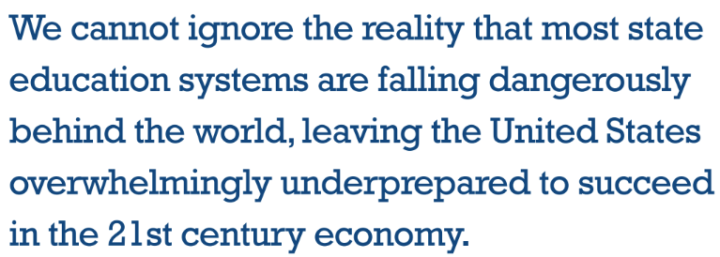
The case for change: by the numbers
In 2016, numerous states and key educational stakeholders completed a broad-based educational study on how US Education was measuring up. The Title gives a hint as to their findings,
“No Time to Lose”.
Reference NCSL publication: “No time to Lose, How to Build a World-Class Education System State by State”

Slide 11
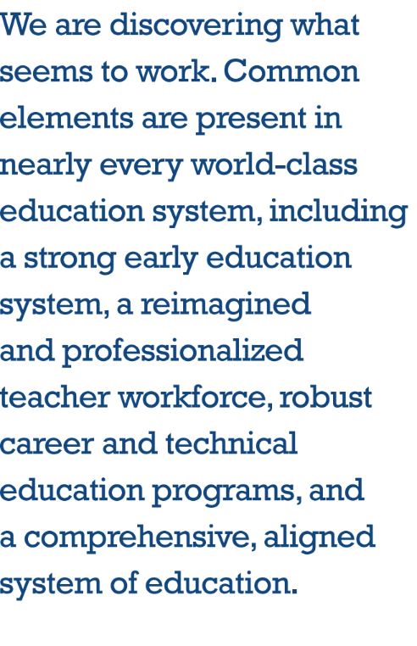
What “No Time to lose found present in the best performers.

Slide 12
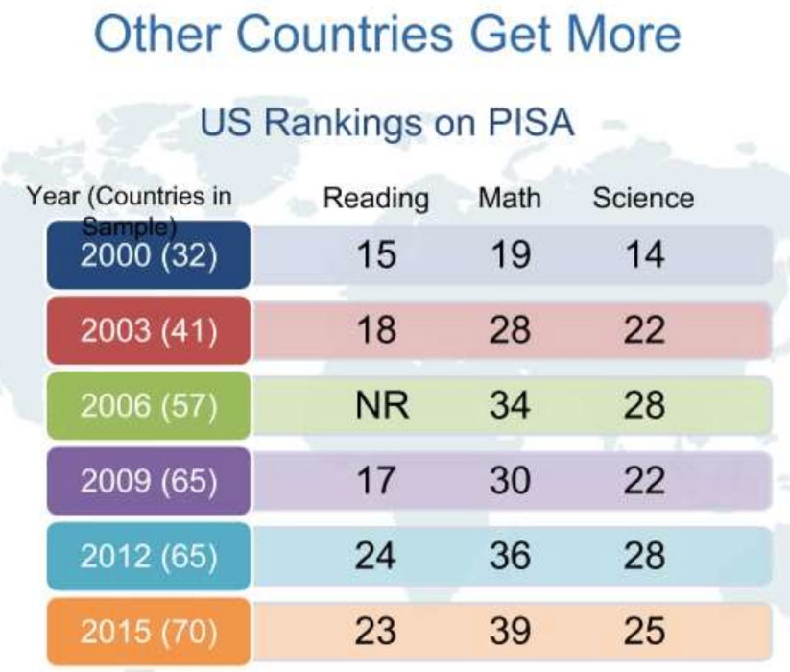
How are we doing Academically as a nation today?
The latest PISA scores reinforce the results from the 2019 National Assessment of Educational Progress (NAEP) test of math and reading, which U.S. fourth and eighth graders take every two years. Those results, released in October 2019, also found that U.S. achievement hasn’t progressed over the past decade and, for low-performing students, was the same as 30 years ago.

Slide 13
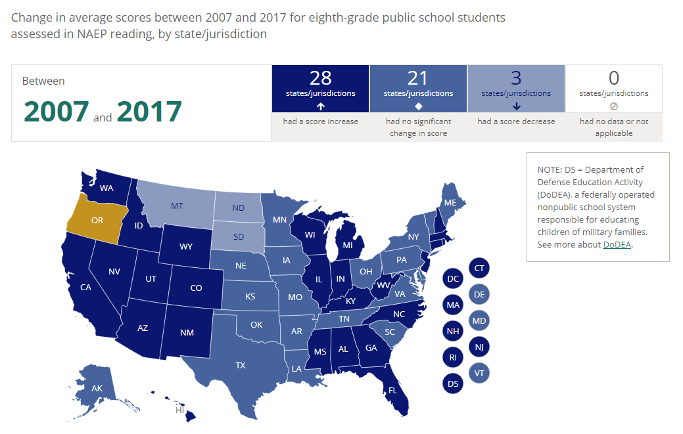
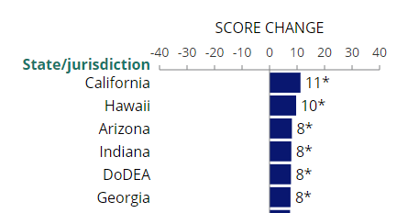
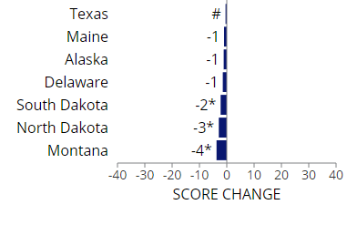
Most Improved
Largest Relative decline
NAEP: National Assessment of Educational Progress
(The Nation’s Report Card)

Slide 14
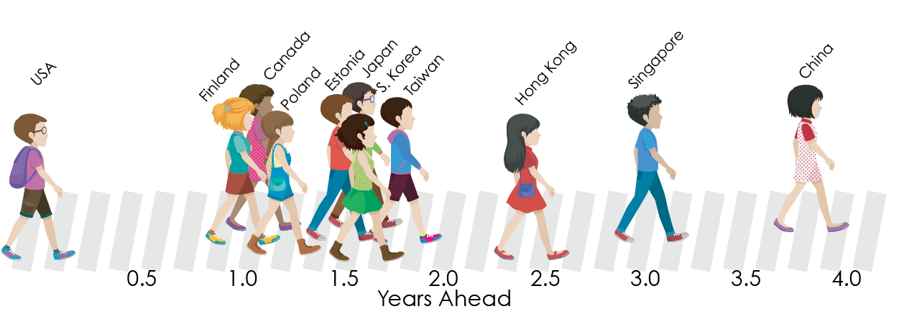
Just How Far Behind Is the Average US Student in Mathematics?
According to data from PISA 2018
In mathematics performance, average US students are more than a year behind students from the top-performing countries. Students in Hong Kong and Singapore are between 2.5 and 3 full years ahead of average US students in math while Chinese students are nearly four full years ahead of US students.
Montana ranks just slightly above national average on NAEP, so how does this suggest Montana would compare at a global level?
November 29-30, 2021 MT Financial Modernization & Risk Analysis Study Committee
Jason Dougal, President & COO of the National Center for Education and the Economy

Slide 15
It is not just a Money Issue
November 29-30, 2021 MT Financial Modernization & Risk Analysis Study Committee
Jason Dougal, President & COO of the National Center for Education and the Economy

Slide 16
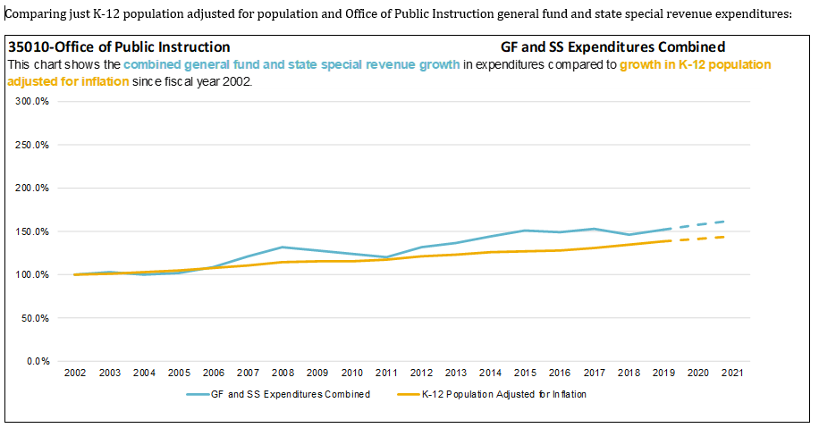
While there is always a need for money, over the past decade Montana Schools have received dollars outpacing both inflation and population growth.

Slide 17
Potential Solutions – How the US Responded
REFORM AGENDA SINCE 1970’S
More money (more than doubled in the last 20 years)
Lower class size
School competition (charters and vouchers)
Technology
Tough test-based teacher-accountability systems
November 29-30, 2021 MT Financial Modernization & Risk Analysis Study Committee
Jason Dougal, President & COO of the National Center for Education and the Economy
Notes:
These are ideas that haven’t worked. Briefly talk through each of the reforms
This leads into the next slides – what we’ve spent and what we’ve got for it.
Lower class size – The data shows positive results for lowering class sizes in early grades, in special education, and in individualized tutoring for struggling learners. But mandating lower class sizes for all students does not improve results, on average. And it is cost prohibitive, especially compared to more effective systemic changes. Good instruction (that yields results) requires diversity in instruction. Consider an example in math. If class size is reduced, you have less diversity in thinking – and problem-solving approaches. More diversity of opinion will benefit the entire class. (example - seeing more ways to solve a math problem than just one way.) The Asian approach to math relies on spending time exploring multiple ways to solve a math problem. When there are more students in a classroom, teachers should be able to find interesting approaches to solving problems – both correct and incorrect.
Charters and vouchers – Charter schools on average do not outperform public schools. There are reports that show strong performers, others not. There are ”pockets of excellence” of charter schools. The same thing can be said for public schools. Our analysis of the research suggests the need for a system that promotes developing teacher expertise (for example). The issue of charters is more a political issue. Denmark has a good charter system – but it is highly regulated and operates in a systemic manner (similar to what we will view as our discussion continues). We’re not saying charters are wrong – or bad. Charters often have advantages that are not necessarily scalable – e.g. cherry-picking strong teachers. Our analysis of the research is that we are all a part of the same broken system – we’re not producing the teachers we need; using an aligned instructional system; no opportunity (career ladder) for teachers to be supported in a continuing manner; etc.
Technology – get a research citation on where technology has been effective and ineffective. The pandemic has shown us a wide the gap is in access – it has also shown us how wide the gap is in quality of instruction using technology as a tool. Educational technology tends to be effective as a tool when it is used in ways that are tied to specific curriculum, grounded in sound theories of learning science, promote student motivation, enable teachers to reflect on and improve their own practice, and promote mutually responsive parent engagement. The problem is that ed tech is not being used thoughtfully or meeting teachers or students where they are in their practice or their learning.
Technology resource: National Bureau of Economic Research (2017). “Education Technology: An Evidence Based Review
Test-based accountability has been around 20 years – what’s it done for us? Hasn’t improved scores (NAEP for example). One argument to be prepared for – If we take the tests away, will some groups of students go back to anonymity and/or invisibility? The concern about lack of attention to special education students, students of color, lower socio-economic students (for example) led to the demand for high-stakes accountability tests. One problem that the US has is that test students so much. No high performing jurisdiction administers standardized accountability tests annually. When you have too many assessments, the amount of money available for each test goes down. That’s what drives machine-scored tests and poor quality of assessment. The cost in exams is not in developing them – it is in grading them. Because we test so much, test items are reused – and not made public. Teachers are guessing at what students are expected to know and do. Cheap, machine-scored, multiple-choice (promoting guessing) testing with questions that are reused has yielded poor results and a fragmented system.

Slide 18
Our Competitors Had a Different Analysis
Rather than modeling their education system on a factory model, they modeled it on a professional working environment
They started with the end in mind
They analyzed their situation and the global context
They designed their entire education system as an engineer would to get the results they wanted
November 29-30, 2021 MT Financial Modernization & Risk Analysis Study Committee
Jason Dougal, President & COO of the National Center for Education and the Economy
Notes:
Workplace in which teachers have authority over what to teach and how
Teachers work together in a professional learning environment as much as they work in front of a class full of students
Like lawyers and doctors
Truly distributed leadership (not just delegated leadership)
Stakes are on students, not teachers (like AP)
Better compensated because the work is professionalized
Fewer exams, but much more writing and conceptually driven and much more transparent
If the goal is to get all kids to a certain proficiency level, then resources need to be allocated accordingly
Leadership model based on engineering/design/architecture rather than administration or direct coaching (What does “Instructional Leadership” mean?)

Slide 19
Our Competitors Had a Different Analysis
Did not double down on the old model (inexpensive teachers; low standards); that model is designed to produce majority of graduates with little more than an 8th grade level of literacy
Knew the jobs available to them would rapidly decline
Needed to provide a world-class education to every single student – equitably and efficiently
All of that required a whole new model
November 29-30, 2021 MT Financial Modernization & Risk Analysis Study Committee
Jason Dougal, President & COO of the National Center for Education and the Economy
Notes:
They had the “benefit” of not having such a well-entrenched production model of education
They often adapted an elite system for a few to expand it to many rather than adapt a mediocre system for all to an elite system for all
There is at least as much local control of teaching, learning, curriculum, assessment and accountability as in the U.S.
This is an opportunity to reference our framework:
https://ncee.org/2017/12/marc-tucker-on-educating-for-an-ai-future/
https://www.edweek.org/teaching-learning/opinion-pisa-on-the-teacher-as-professional/2013/12

Slide 20
Their Model vs. Ours
THE 2018 PISA RESULTS
In reading…
8 systems outscored the U.S.
11 systems were statistically tied with the U.S.
57 systems scored worse than the U.S.
In mathematics…
30 systems outscored the U.S.
8 systems were statistically tied with the U.S.
39 systems scored worse than the U.S.
In science…
11 systems outscored the U.S.
11 systems were statistically tied with the U.S.
55 systems scored worse than the U.S.
November 29-30, 2021 MT Financial Modernization & Risk Analysis Study Committee
Jason Dougal, President & COO of the National Center for Education and the Economy
Source: OECD
Notes:
Note the expanding number of countries (no longer just industrialized nations)
U.S. has fallen behind the likes of Vietnam
Falling behind more and more countries
Just into top third in Reading and Science
Slightly below average in Math
*Outperformed by a statistically significant margin. Many more countries had higher average scores, but the difference was not statistically different.
NOTE TO FACILITATORS: We need to shift from talking about where the US “ranks” on PISA. A number of countries outperform the US on PISA but this is different from where the US “ranks on a league table” based on raw score. A number of countries are in a statistical tie with the US; we can’t say one way or another whether the US ranks ahead of or behind them. Statisticians have (rightfully) hammered us on this point a number of times. Instead, we need to talk about how many countries have score differences that are statistically significant from the US.

Slide 21
What is Personalized Learning? An educational approach that aims to customize learning for each student’s strengths, needs, skills, and interests. Each student gets a personalized learning plan that’s based on what they know and how they learn best. Personalized learning does not replace an IEP, a 504 plan, or intervention programs. What is Proficiency Learning? A competency-based educational approach focused on student’s demonstration of desired learning outcomes. Students can gain the skills, abilities, and knowledge required in an area of study, along with those necessary to be successful in college career and civic life inside or outside of the traditional classroom. Proficiency learning is designed to identify and address gaps in order to provide personalized learning opportunities for every student. This is in contrast to traditional systems which advance students based on seat time. What are the core elements of Personalized and Proficiency Learning? Approaching each student with a deep understanding of that learner and the development of their learning profile focused on individual learning preferences, strengths, challenges, and readiness to learn. Content can be delivered via teacher instruction, digital learning, and interdisciplinary projects both alone and in groups leading to strong problem solving, collaboration, analyzing and critical thinking skills. Students are involved in determining how they will demonstrate proficiency and mastery of a standard or concept. Once proficiency is demonstrated, the student moves on, resulting in personalized student-centered approach accelerating progress and preparing each individual student to fulfill their full educational potential.
Personalized, proficiency-based education

Slide 22
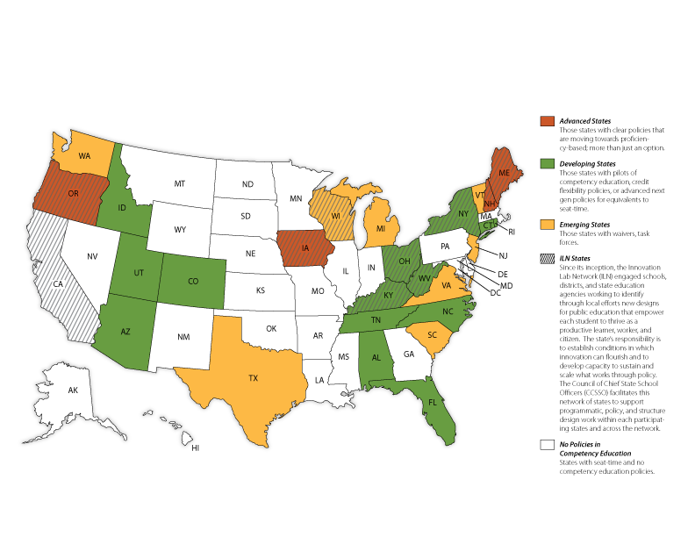
A Snapshot of States: K-12 Competency-based Education Policy
2012
22

Slide 23
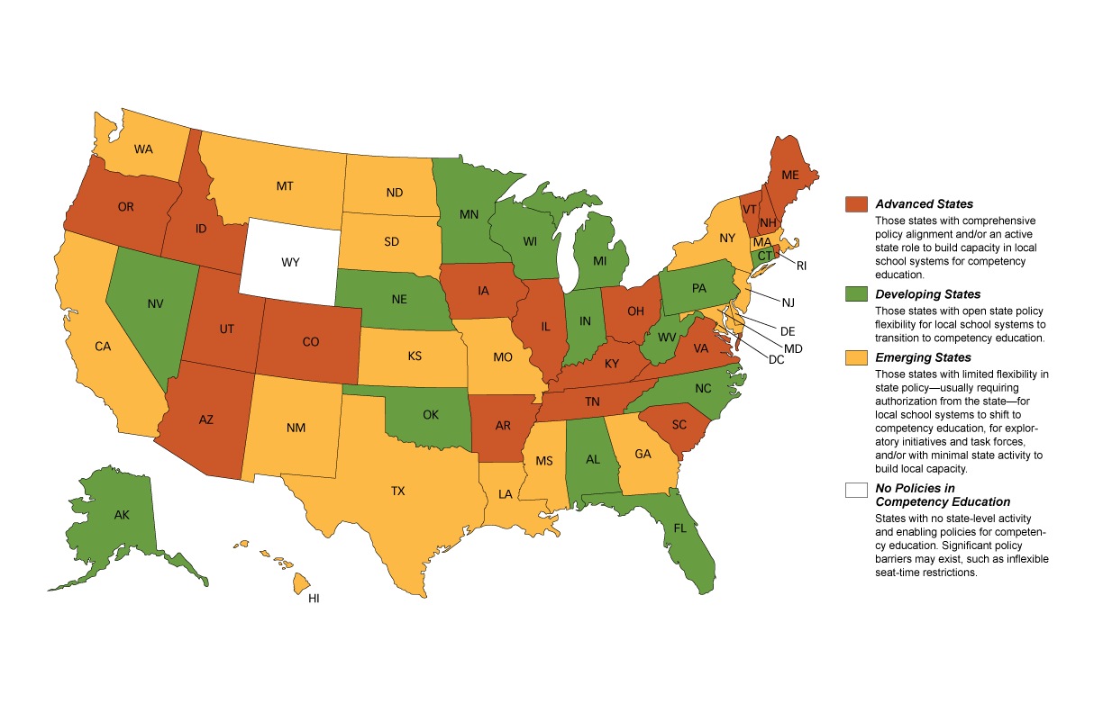
A Snapshot of States: K-12 Competency-based Education Policy
We have moved the needle some
2019
23

Slide 24
State Policy: Entry Points to Create Personalized, Competency-Based Education Systems
Montana
24

Slide 25
FLEXIBILITY LINCHPINS IN RULE: Rules of the MT Board of Public Education
There is flexibility in courses required for graduation.
10.55.906(3) The local board of trustees may waive specific course requirements based on individual student needs and performance levels.
There is flexibility in the pace and methods by which students become proficient.
10.55.906(4): With the permission of the local board of trustees, a student may be given credit for a course satisfactorily completed in a period of time shorter or longer than normally required…
Moved from current “seat time fixed and D- passing” to “seat time varies as needed and proficiency/mastery required to proceed.”
There is flexibility in licensure:
National board-certified and successful educators from other states.
Class 4 CTE Licensure available to Industries and trades those with a high school diploma and 10,000 hours of experience. ARM Section 10.57.420 and 421
Additional flexibilities continue to be explored.

Slide 26
MT LEGISLATIVE ACTION EMPOWERING PERSONALIZED PROFICIENCY LEARNING
Proficiency/Competency Learning:
First for individuals in (Jones SB 175, 2013)
Later for systems (Jones SB 103, 2017).
Pilot Programs:
Transformational Learning (McKammey HB351, 2019)
“Transformational Learning” as a name was favored by SAM (School Administrators of Montana) during the legislative process to define proficiency based personalized learning.
20-7-1601. Transformational learning -- legislative intent. The legislature finds and declares pursuant to Article X, section 1, of the 1972 Montana constitution that transformational learning is an appropriate means of fulfilling the people's goal of developing the full educational potential of each person. The provision of and participation in transformational learning under this part and in compliance with accreditation standards of the board of public education is constitutionally compliant and protected. The legislature declares that any public or private regulation that discriminates against a district or pupil participating in transformational learning is inconsistent with constitutional goals and guarantees under Article X of the Montana constitution.
Advanced Opportunities (Jones, HB387, 2019):
"Advanced opportunity" means any course, exam, or experiential, online, work-based or other learning opportunity that is incorporated in a district's advanced opportunity plan and that is designed to advance each qualifying pupil's opportunity for postsecondary career and educational success.”

Slide 27
2021 CODIFICATION OF PERSONALIZED LEARNING AND WORK-BASED LEARNING
House Bill 246 (Bertoglio, 2021), Comprehensive codification of personalized learning and enhanced power and authority of elected school boards.
Includes a legislative acknowledgement that all duties of elected school boards are performed as part of the authority of each elected school board to exercise supervision and control of the schools of the district pursuant to Article X, section 8, of the Montana Constitution.
Expands the definition of instruction that is used to calculate aggregate hours of pupil instruction for funding purposes, to place new emphasis on the intended outcome of learning. The expanded definition codified in 20-1-101 now includes “any directed, distributive, collaborative, or work-based or other experiential learning activity provided, supervised, guided, facilitated, or coordinated under the supervision of a teacher that is conducted purposely to achieve content proficiency and facilitate the acquisition of knowledge, skills, and abilities by pupils enrolled in public schools, and to otherwise fulfill their full educational potential.”
Further emphasizes and supports work-based learning opportunities through codification of certification flexibilities and course credit allowances and amendment of the definition of pupil instruction.
Codifies school board authority to waive courses and declare equivalent learning.
Clarifies a college professor can teach a course to K-12 students for college credit.
Codifies licensure for successful educators from other states and provides interpretive guidelines meant to ensure a regulatory approach that prioritizes granting, as opposed to denying, licenses to successful educators from other states.
Expands access of students to offsite instruction for advanced placement, dual credit and career certification courses. (If a local school will not provide personalized work-based learning options, students can take ¼. Or ½ of their AnB monies with them to the nearest District that will provide these options while still retaining all the privileges of being part of their home school.

Slide 28
LINCHPIN OF FLEXIBLITY: SEAT TIME AND TEACHING METHODS
There is Flexibility in Seat Time: ARM Section 10.55.906(4) aligns with proficiency-based ANB, Transformational Learning, and Advanced Opportunity as adopted by the Montana Legislature.
10.55.906(4): “With the permission of the local board of trustees, a student may be given credit for a course satisfactorily completed in a period of time shorter or longer than normally required and, provided that the course meets the district's curriculum and assessment requirements, which are aligned with the content standards stated in the education program. Examples of acceptable course work include those delivered through correspondence, extension, and distance learning courses, adult education, summer school, work-study, specially designed courses, and challenges to current courses. Acceptable programs must be consistent with the local board of trustees' policy.
Limited utilization to date: Most School Trustees are unaware this is possible, and some administrators are either unaware or hesitant to change the status quo.

Slide 29
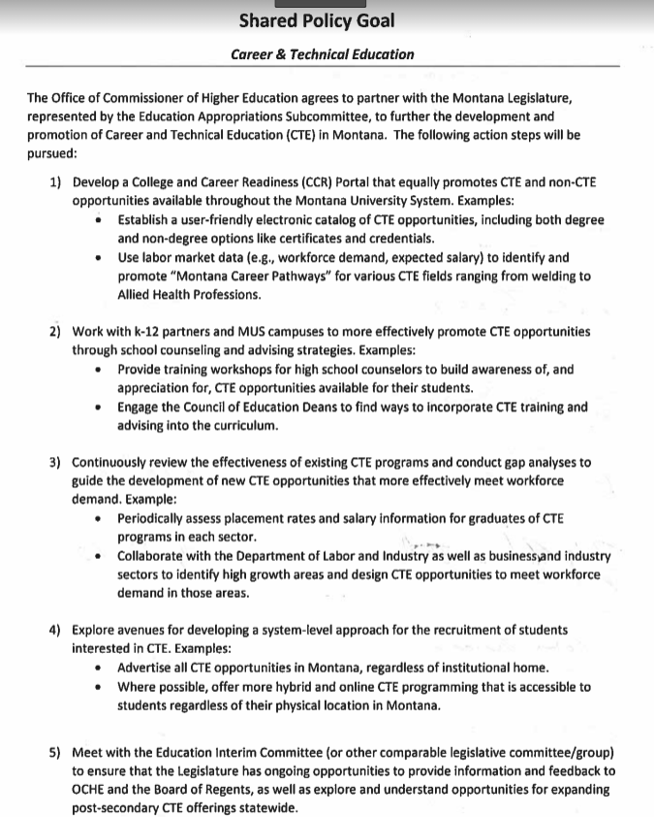
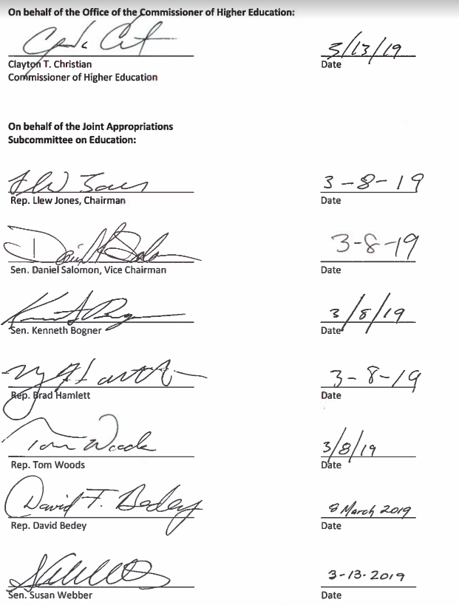
Higher Education and cte: a shared policy goal

Slide 30
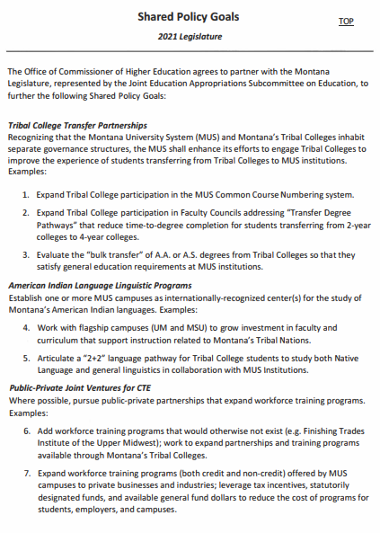
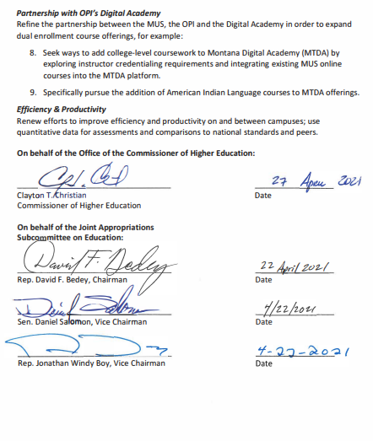

Slide 31
Currently Underway
2021 Legislature authorized $1,000,000 for a MSU pilot effort to increase the focus of teacher education on proficiency outcomes.
OPI is working to pilot a residency-based student-teacher model, beginning fall 2022. (The student-teacher remains in the community for 1 year, with provided housing and a stipend. Requires a 2-year teaching commitment to Montana.)
Governor’s Office & MT DLI are working via Build Montana to engage businesses and school partnerships all over Montana in experiential, work-based learning focused on industry driven, stackable CTE credentials. Montana School Board Association is focusing on leading the schools through the steps to innovate and utilize the available legislative flexibilities.
OCHE/MUS System is pursuing a GEER grant from Governor to create a single dual credit and CTE interface system statewide, dramatically simplifying college and career planning for counselors and students.
MT Digital Academy conversations are underway about the expansion of options. An Amazon-like interface to the professional, relevant, industry-driven content from anywhere, not just Montana.

Slide 32
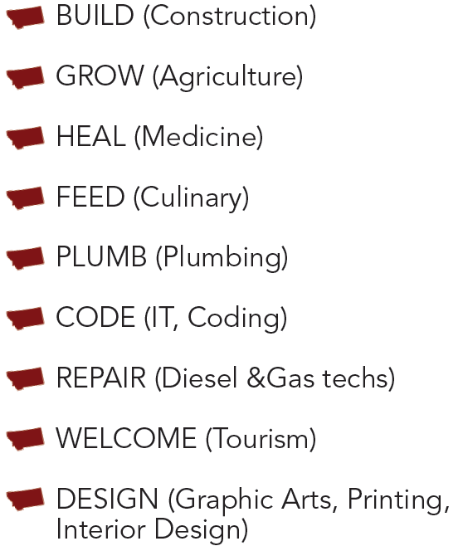
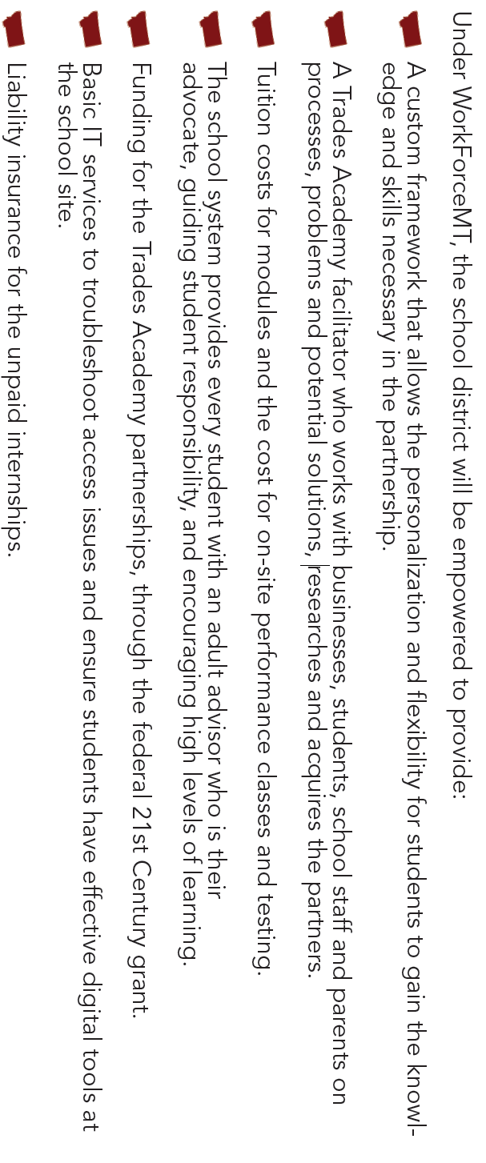
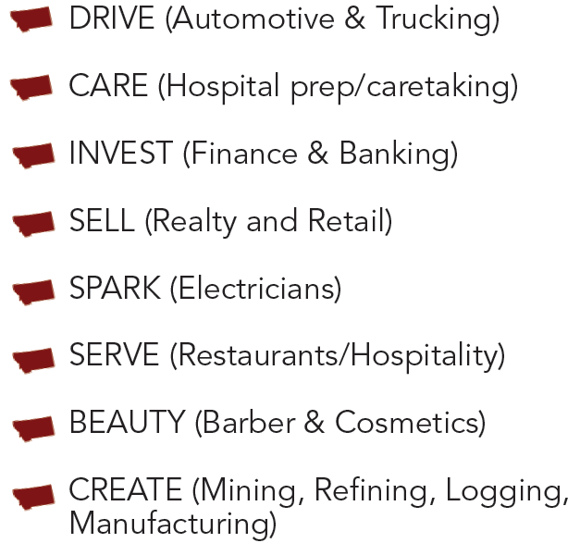
WHAT IS “BUILD MONTANA”?
Montana’s Industry Driven Workforce Development Pipeline
Legislation has opened the CTE interface
Proficiency based learning releases Student seat time 20-9-311(4)d
(SB175 Jones 2013)
System wide school flexibility-allows for declared equivalency-20-1-301
(SB103 Jones 2017)
Locally controlled Schools
WorkForce MT
Advanced Opportunities CTE-Education Workforce Partnerships
(HB387 Jones 2019)
Transformational Learning
8-year incentive package to move schools towards Performance/Mastery learning including workforce partnerships
(HB351 McKamey 2019)
Original PDF Design: MT Representative Llew Jones &
Deputy Superintendent Sharyl Allen, MT OPI

Slide 33
ACCELERATE MONTANA PARTNERSHIP
Housed through the University of Montana
ARPA Workforce Commission approved $6M in funding focused on building Montana’s talent pipeline through rapid training.
Construction, health care, manufacturing, tech.
5,000 new employees for jobs in in-demand sectors across the state.
Regional recruitment coordinators working with Job Service.
Regional delivery by partnering with Montana University System institutions, private colleges, tribal colleges, and high schools to deliver coursework.
Collaborating with private businesses and State and Local Chambers to raise awareness and place trainees in jobs.

Slide 34
Q: Are students required to be paid a wage during personalized work-based learning? A: No. Employers and Local School Administrators evaluate each educational opportunity for compliance with the educational requirements of state and federal law, and have the flexibility to choose the best path for each opportunity. (See: MT HB246 & USDOL Fact Sheet #71) Q: Are K12 work-based learning experiences apprenticeships? A: They can be, but formal internship or apprenticeship is not required. Q: How are students covered for workers’ compensation during work-based learning? Employers and Local School Administrators evaluate each educational opportunity and have the flexibility to choose whether the school or the employer will insure the student. (HB282 Anderson, 2021; HB 283 Anderson, 2021) Q: WSD Questions?
Questions:

