Slide 1
Agenda
SNAP E&T Overview
SNAP E&T Goals
Strategy to Grow the Program
Q&A
Notes:
We understand that changes with ABAWD will impact a large population of Montana’s and want to remind staff that Montana’s overarching goal is to help individuals gain self sufficiency by supporting clients through overcoming barriers to employment and accessing resources in their communities. When speaking with client’s please remember to go over additional resources within your communities that may be able to assist them, such as WIC, the Best Beginnings Program and local food banks and soup kitchens.

Slide 2
SNAP E&T Overview
Notes:
We understand that changes with ABAWD will impact a large population of Montana’s and want to remind staff that Montana’s overarching goal is to help individuals gain self sufficiency by supporting clients through overcoming barriers to employment and accessing resources in their communities. When speaking with client’s please remember to go over additional resources within your communities that may be able to assist them, such as WIC, the Best Beginnings Program and local food banks and soup kitchens.

Slide 3
WHAT IS SNAP E&T?
Required by federal partners – some funding provided
Helps SNAP participants gain skills and find work that moves them forward to self-sufficiency
Participants have access to training and support services to help them enter or move up in the workforce
Helps reduce barriers to work by providing support services

Slide 4
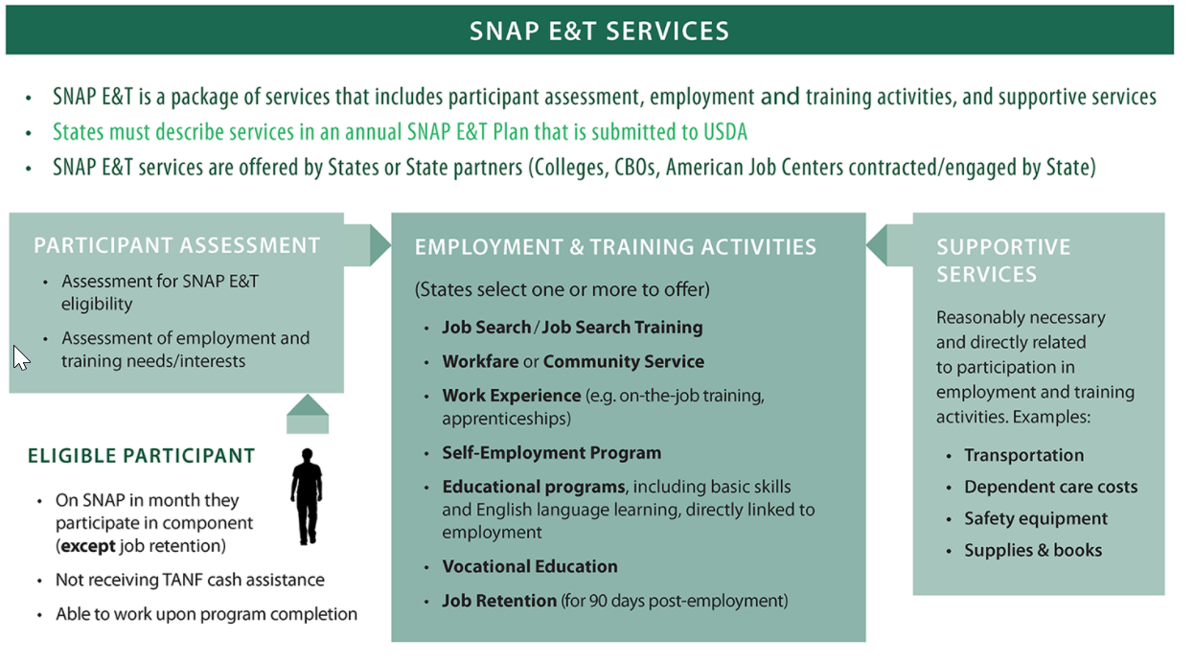

Slide 5
WHAT SUPPORT SERVICES DOES MONTANA PROVIDE?
Case Management
Services include, but are not limited to:
Intake
Testing and assessment
Weekly meetings
Employability planning
Job development and placement
Job Training and Support
Services include, but are not limited to:
Job skills assessment
Resume writing
Interviewing techniques
Soft skills classes
Basic Education
Basic education activities may include the following:
High school
Alternative high school
High School Equivalency Test (HiSET)
Basic/remedial education programs

Slide 6
WHAT SUPPORT SERVICES DOES MONTANA PROVIDE?
Vocational Education
Training can be offered by an educational institution, learning center, employer, or related institution and referrals may include, but are not limited to, the following:
Flagging/Construction
Welding
Computers
Office Assistant
Certified Nurses Aide (CNA)/Certified Medical Assistant (CMA)/Phlebotomy
Certified Drivers License (CDL)
Apprenticeship (Electrician, HVAC, Plumbing)

Slide 7
WHAT SUPPORT SERVICES DOES MONTANA PROVIDE?
Self-Employment
Offers training to:
Design and operate a small business or another self-employment venture
Guidance provided for those with sound business ideas but lacking the skills and knowledge to successfully create and implement a plan
Technical assistance in developing business plans and financial marketing plans
Access small business grants and other business support services
Job Retention
Assists participants on a case-by-case basis providing supportive services for a minimum of 30, and maximum of 90, days of the participants new employment
Services must be reasonable and necessary and may include:
Clothing required for employment
Equipment or tools required by the employer
Transportation such as a fuel card or bus pass
Support from the SNAP E&T Case Manager

Slide 8
SNAP E&T Goals

Slide 9
MONTANA’S GOAL
Montana’s overarching goal is to help individuals gain self-sufficiency by supporting clients through…
Overcoming barriers to employment
Accessing resources in their communities to enhance food availability and healthy options
To further this effort, Montana is looking to expand SNAP E&T services across the state
Notes:
We understand that changes with ABAWD will impact a large population of Montana’s and want to remind staff that Montana’s overarching goal is to help individuals gain self sufficiency by supporting clients through overcoming barriers to employment and accessing resources in their communities. When speaking with client’s please remember to go over additional resources within your communities that may be able to assist them, such as WIC, the Best Beginnings Program and local food banks and soup kitchens.

Slide 10
WHERE SERVICES ARE NOW
Expansion Goals:
8 Counties -2022
13 Counties -2023
56 Counties -2027
Notes:
ABAWDs who have exhausted all their initial ABAWD months are disqualified from receiving SNAP until they meet one of the following exemptions…
A new ABAWD span begins
They qualify for extended months
They meet an individual exemption
They gain a work registration exemption
Live in a geographically exempt location

Slide 11
Strategy to Grow the Program

Slide 12
WHAT IS MONTANA LOOKING FOR?
An Intermediary Contractor to…
Provide, or sub-contract, SNAP E&T services across the state of Montana using in-person and virtual methods
Assist eligible SNAP household members in gaining skills, training, and work experience
Identify other possible sources of funding for operations and to maximize contractor’s investments with 50/50 SNAP funds by securing non-Federal funds to receive additional 50/50 funds from FNS reimbursement

Slide 13
ROLE OF AN INTERMEDIARY
Intermediaries may…
Carry out several required and essential administrative tasks
Provide support to State SNAP E&T programs by centralizing operational and fiscal functions
Increase capacity
Leverage established leadership roles, key partnerships and expertise within the workforce

Slide 14
BENEFITS OF AN INTERMEDIARY
For the Client…
Improved access to Employment and Training services
Assistance in achieving self-sufficiency
For the Intermediary…
Leverage established roles, partnerships and expertise
Leverage non-federal funding already being used in the workforce arena (50-75%)
Increase community partnerships and trusting relationships
For the State…
Provide flexibility that may not be available within the State government
Expand services to more clients
Speed up securing E&T partners
Stable source of allowable Non-Federal funding

Slide 15
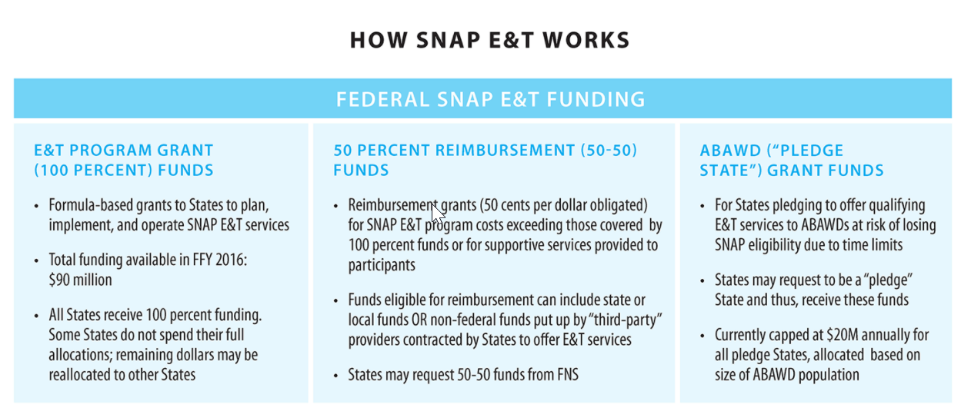

Slide 16
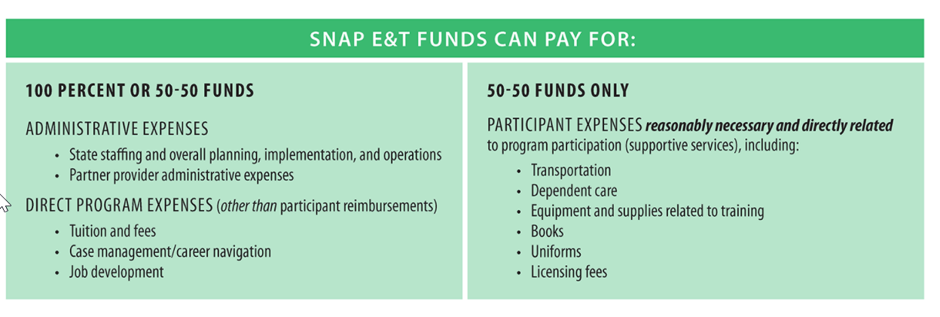

Slide 17
POTENTIAL FUNDING for MONTANA STRATEGY
Initial Contract
Award date of RFP to 09/30/2023
Federal Fiscal Year (FFY) 2022 and 2023
Potential for extensions up to a total of seven years
FFY 2022 and 2023 funding sources:
100% Federal Administrative
American Rescue Plan Act (ARPA)
50/50 Federal Reimbursement
FFY 2024 and ongoing funding sources:
100% Federal Administrative
Increased 50/50 Federal Reimbursement
Over a period of 2 – 5 years, the contractor will transition to providing services using only increased 50/50 Federal Reimbursement funds.
This process will free up limited 100% Federal Administrative funds, which will be recycled to a new service area each year and support the continued expansion of the SNAP E&T program.

Slide 18
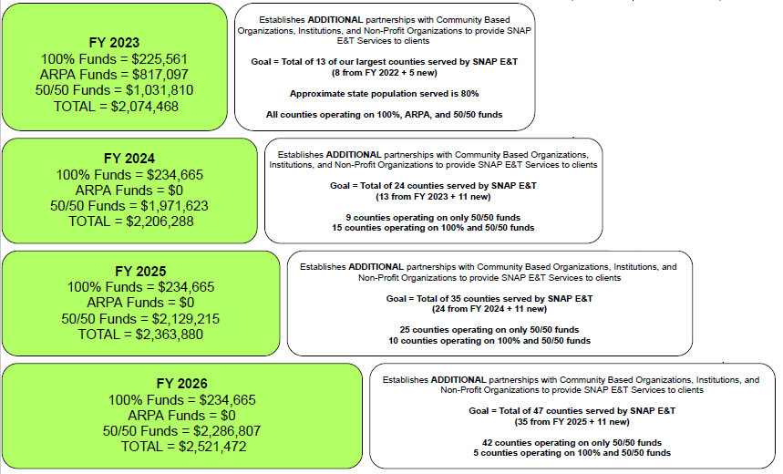
POTENTIAL FUNDING - EXAMPLE

Slide 19
HOW THE FUNDING WORKS
SNAP E&T Federal Funds
Non-Federal E&T Funds (i.e., private donations)
Intermediary
Sub-Contractor
Sub-Contractor
Sub-Contractor
Sub-Contractor

Slide 20
HOW THE FUNDING WORKS
SNAP E&T Federal Funds
Non-Federal E&T Funds (i.e., private donations)
Intermediary
Sub-Contractor
$5,000* CDL training paid, receipt submitted, reimbursement requested
$2,500 approved and reimbursed through SNAP E&T 50/50 funds
(loses Federal identity)
* Reimbursement can only occur on Non-Federal funds (FNS cannot reimburse FNS)

Slide 21
BENEFITS OF AN INTERMEDIARY
BUDGET
 |  |  | Partnership | Individual
Beginning Budget |  |  | $100,000.00 | $100,000.00
01/01/2022 | CDL Training | $5,000.00 | $95,000.00 | $95,000.00
01/20/2022 | CNA Training | $1,000.00 | $94,000.00 | $94,000.00
01/31/2022 | CDL License | $100.00 | $93,900.00 | $93,900.00
 |  |  | Submit January expenses for reimbursement on 02/01/2022
02/03/2022 | Phlebotomy Training | $1,250.00 | $92,650.00 | $92,650.00
02/15/2022 | January Reimbursement | $3,050.00 | $95,700.00
02/17/2022 | Scrubs | $150.00 | $95,550.00 | $92,500.00
02/22/2022 | Bus Pass | $50.00 | $95,500.00 | $92,450.00
02/28/2022 | Nursing License | $1,500.00 | $94,000.00 | $90,950.00
 |  |  | Submit February expenses for reimbursement on 03/01/2022
03/15/2022 | February Reimbursement | $1,475.00 | $95,475.00
Ending Budget |  |  | $95,475.00 | $90,950.00
2 MONTHS
Total Exp = $9,050
Total Reimbursement = $4,525
12 MONTHS
Total Exp = $54,300
Total Reimbursement = $27,150
~ 27% Budget Increase

Slide 22
Questions & Answers
Notes:
This concludes this month’s refresher training. I will now unmute the audience to ask questions.
If there are questions that you think of after the presentation please feel free to email those to your supervisor. Supervisors please forward those to me. I will email the field once the questions have been reviewed by the policy specialists.

