Slide 1
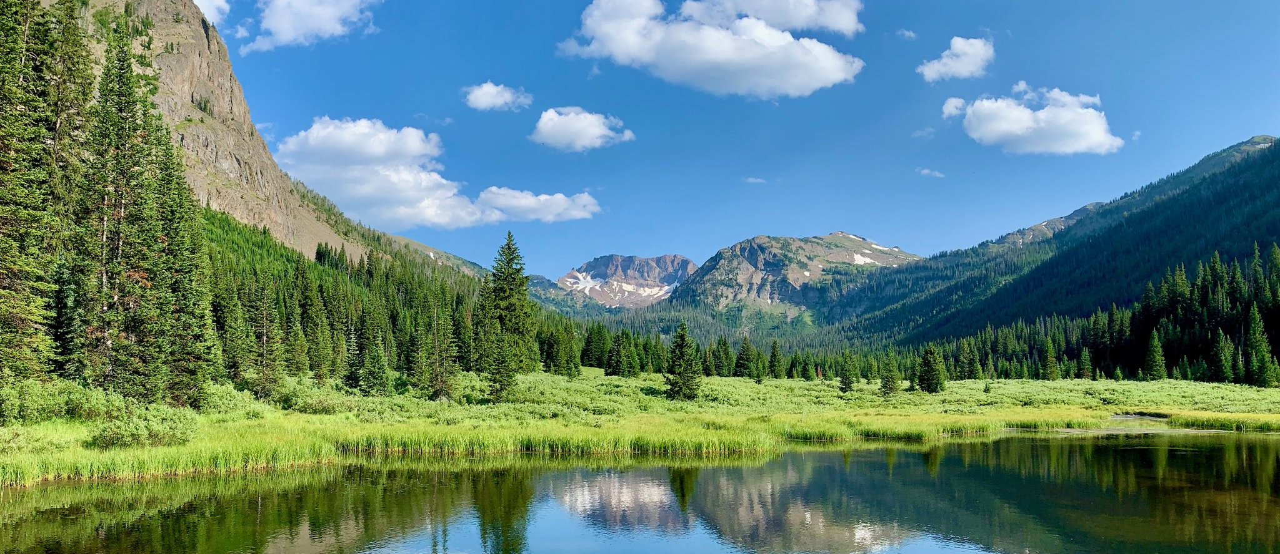
Montana’s Worker Shortage April 2022
Presentation to the SWIB by Barbara Wagner
Chief Economist

Slide 2
Unemployment Rate Lower than Ever
2.3%
Source: CPS and LAUS, BLS & MTDLI

Slide 3
Labor Force Participation Rates
62.4%
Montana
US
Source: CPS and LAUS, BLS & MTDLI

Slide 4
Montana Labor Force Participation Rate
Source: CPS and LAUS, BLS & MTDLI

Slide 5
Labor Force Participation by Age: Most above pre-pandemic levels
Up 0.9%
seasonal
People move from here to here.
Down 0.2%
Up 1.3%
Lmi.mt.gov/home/job-tracking, Current Population Survey, complied by MTDLI

Slide 6
Montanans Not in the Labor Force by Reason
Source: IPUMS CPS Data Montana 12-Month Moving Average. Includes people 15 and up.
Notes:
854,000 in montana in 1994

Slide 7
Montana Parents: Labor Force Participation Recovered
60,000 Parents are Still Working Reduced Hours
Lmi.mt.gov/home/job-tracking

Slide 8
Labor Force Participation Rates of Montana Men vs. Montana Women
Men
Women
Source: IPUMS CPS Data Montana 12-Month Moving Average. Includes people 15 and up.

Slide 9
More Workers Employed in March 2022 than Ever Before
Source: LAUS, MTDLI.

Slide 10
Payroll Jobs in Select Industry Compared to Pre-recession Peak
Source: CES, MTDLI

Slide 11
Labor Market Tightness Causes
Supply of Workers
Aging workforce driving reduced participation
Illness & COVID results in fewer work hours available
Childcare issues causing reduced hours
Young & men lagging response to higher wages
More working for out-of-state remote employers?
Even with aging population,
WE STILL HAVE MORE WORKERS THAN EVER BEFORE

Slide 12
Is the same true for US? NO US labor force not recovered
25 to 54 years
16 to 24 years
55 years and older
Source: CPS, BLS

Slide 13
Is the same true for US? NO US labor force not recovered
Source: CPS, BLS

Slide 14
US Unemployment & Rate are near lows (but with no growth in LF)
Source: CPS, BLS

Slide 15
US Labor Force & Employment Levels Still Down
Source: CPS, BLS

Slide 16
Labor Market Tightness Causes
Supply of Workers
Aging workforce driving reduced participation
Illness & COVID results in fewer work hours available
Childcare issues causing reduced hours
Young & men lagging response to higher wages
More working for out-of-state remote employers?
Even with aging population,
WE STILL HAVE MORE WORKERS THAN EVER BEFORE

Slide 17
Economy is Booming: Montana Quarterly Real GDP
Source: Bureau of Economic Analysis. Pre-recession peak in 2019Q4
Notes:
Real GDP grew by 6.7% in 2021 (over 2020), faster than the U.S. growth of 5.7% and ranking 7th among states.
Montana’s personal income grew by 8.5% in 2021 (over 2020), faster than the U.S. growth of 7.4% and ranking 12th among states.
The 8.5% increase in personal income was the fastest increase in Montana’s personal income since 2006.
Consumer spending in Montana in February 2022 was 6.6% higher than it was prior to the pandemic.

Slide 18
MT real GDP by Industry
Source: BEA

Slide 19
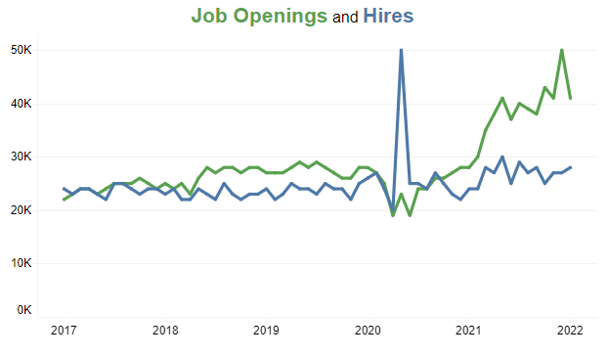
Job Openings at Record Highs
Jan 2022
41,000
28,000
Source: BLS, JOLTS

Slide 20
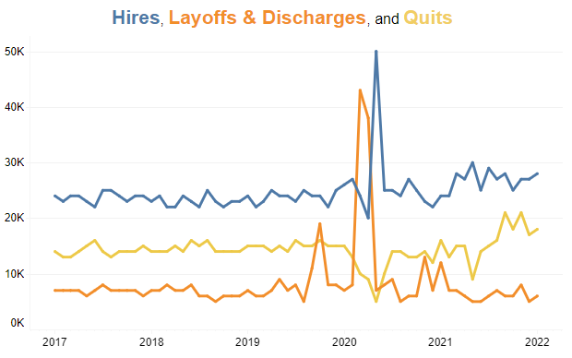
Openings Partially due to Worker Churn (which is good for economy)
Roughly 20,000 quits/month.
Worker re-adjustment promotes increased productivity and higher wages
Source: BLS, JOLTS

Slide 21
Strong Wage Growth Average Wage over Last 4 Quarters & Growth
Average wage over Prior 4 Quarters
Growth
Source: Total Wages from QCEW, MTDLI.
Notes:
Wages paid to Montana workers have increased sharply during the pandemic. The average weekly wage in 2021Q3 was $963, over $115 higher than the same quarter in 2019, for rapid growth over the two years of roughly 14%. In comparison, it took nearly five years from 2014 to 2019 to increase average weekly wages by the same amount.

Slide 22
Wage Growth has Exceeded Inflation
Estimated
Source: Estimate based on growth in 2021 first three quarters. Total Wages from QCEW, MTDLI.

Slide 23
Labor Market Tightness Causes
Demand for Workers
Positive economic shock & rapid growth
High turnover rates as workers seek out better jobs
High worker absenteeism increases worker needs
(~ 14k out due to COVID in early Jan)
Supply of Workers
Aging workforce driving reduced participation
Illness & COVID results in fewer work hours available
Reduced hours from childcare issues
Young & men lagging response to higher wages
Potential competition from remote employers

Slide 24
Very Few Unemployed People
People currently unemployed likely to have
Multiple barriers to work
Seasonal jobs
Home outside urban areas
Source: LAUS, MTDLI.

Slide 25
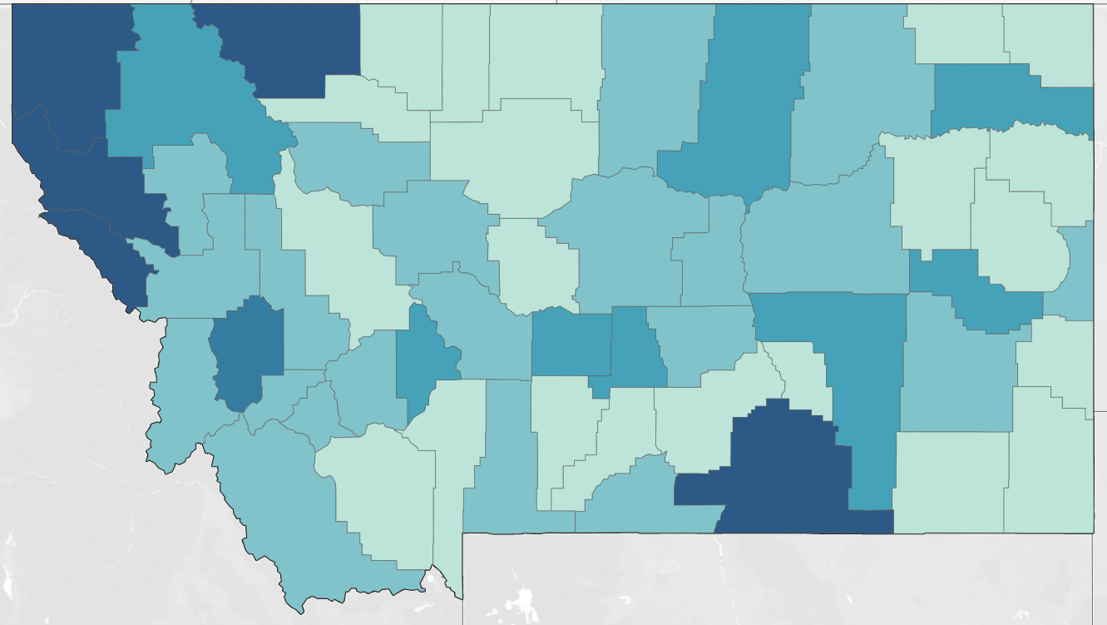
County Unemployment Rates
6.3%
5.9%
6.1%
Source: LAUS, MTDLI.
Notes:
Unemployment rates vary geographically

Slide 26
Inflation Present in Imports, Producer Prices, and Consumer Prices
Source: CPI-U, BLS

Slide 27
Montanans Not in the Labor Force by Reason
Source: IPUMS CPS Data Montana 12-Month Moving Average. Includes people 15 and up.

Slide 28
Where to Find More Workers?
Increase …
Work hours of existing workers (still lower than pre-recession)
Multiple job-holding
Productivity
In-migration (comes with some housing/growth issues)
Childcare
Tap into retirees, disabled workers, students, and caretakers
Embrace remote work
Look for labor-saving productivity improvements
Everyone not working has a good reason – accommodate it!
In 2024, retirements slow & labor force growth accelerates*
*working on an update including post-pandemic period
Notes:
In-Migration: Montana had the 3rd fastest population growth in the US 2020-2021 (18,000 people) In-migration of 19,791, net loss 1,520 from natural increases.

Slide 29
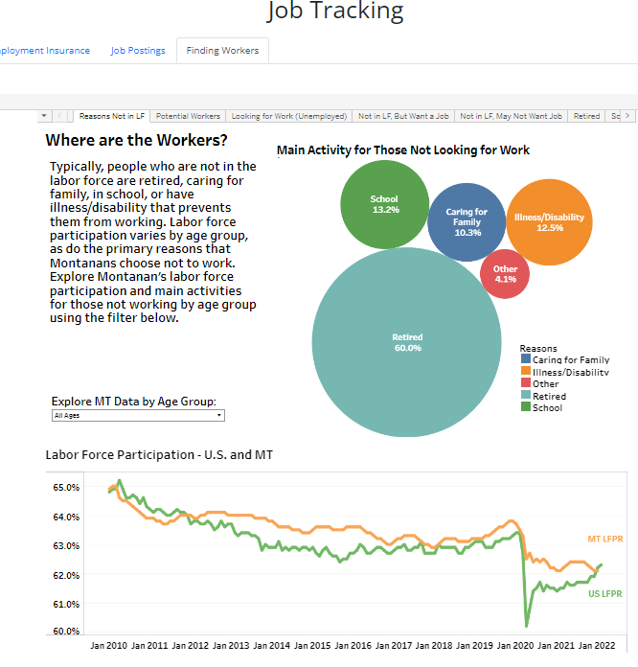
See updates!
lmi.mt.gov/home/job-tracking
Click the “Finding Workers” Button

