Slide 1
Local Workforce Development
Presented by:
Jackie Haines, Economic Development Director, HRDC District IX
Meagan Lannan, Manager, DLI WSD Job Service—Livingston

Slide 2
The Workforce Shortage Today
Gallatin County – April 2016 Park County – April 2016
-Unemployment Rate: 2.8% -Unemployment Rate: 4.9%
-Total Labor Force: 59,856 -Total Labor Force: 8,128
-Total Unemployed: 1,655 -Total Unemployed: 402
Source: Montana Labor Market Information
Source: Montana Labor Market Information

Slide 3
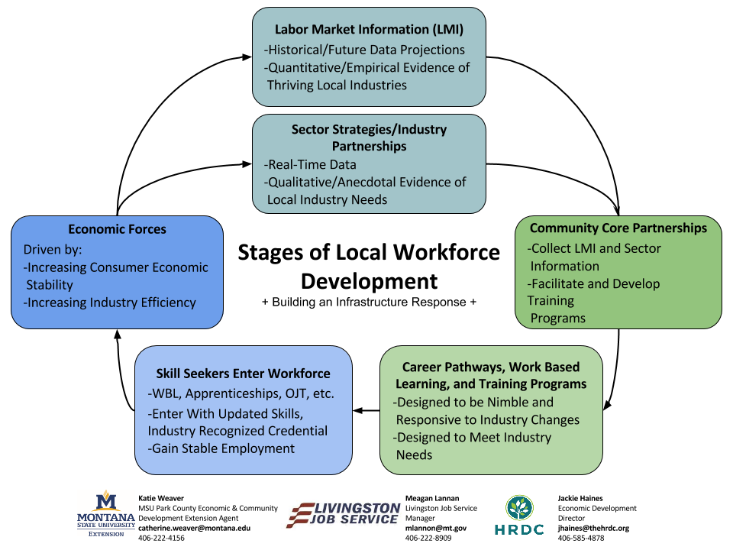

Slide 6
Questions?
Contact:
Jackie Haines
jhaines@thehrdc.org
406-585-4878
Meagan Lannan
mlannan@mt.gov
406-222-8909
Katie Weaver
catherine.weaver@montana.edu
406-222-4156

